Slide 2
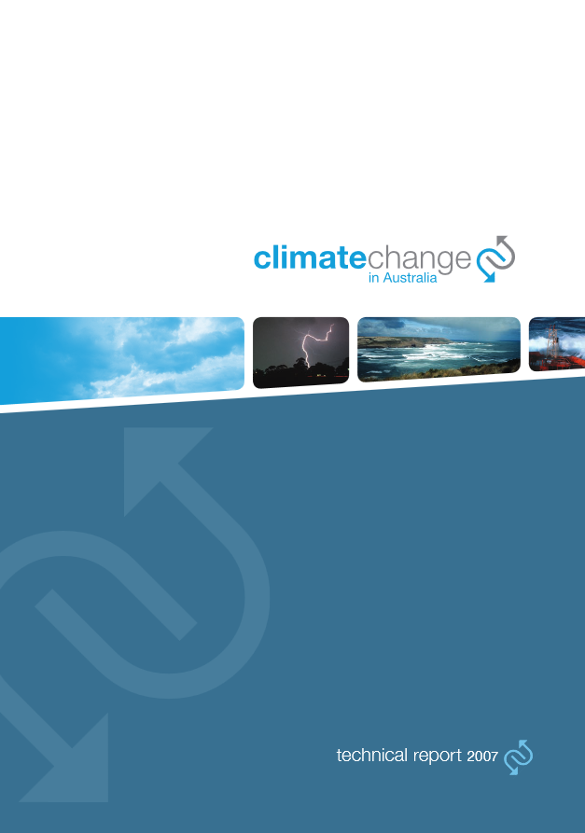
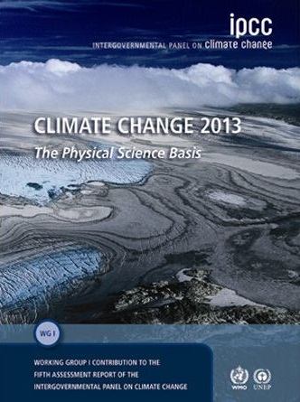
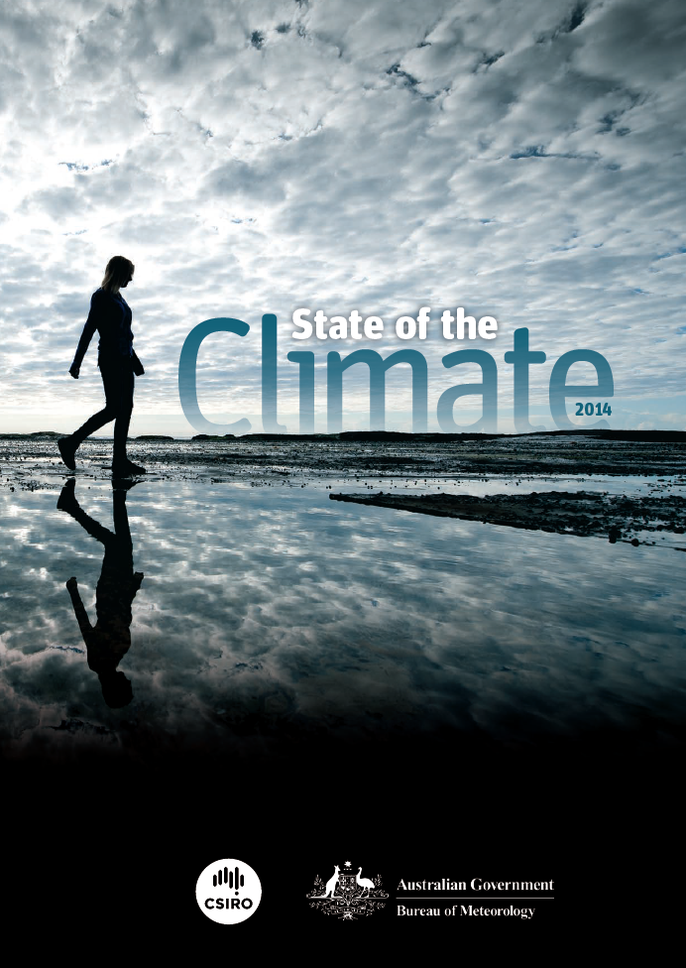
The latest research builds upon
Climate Change in Australia (2007)
IPCC 5th Assessment Report (2013)
State of the Climate (2014)
Notes:
IPCC
State of the Climate
Pic of each
2007 projections – similar results

Slide 3
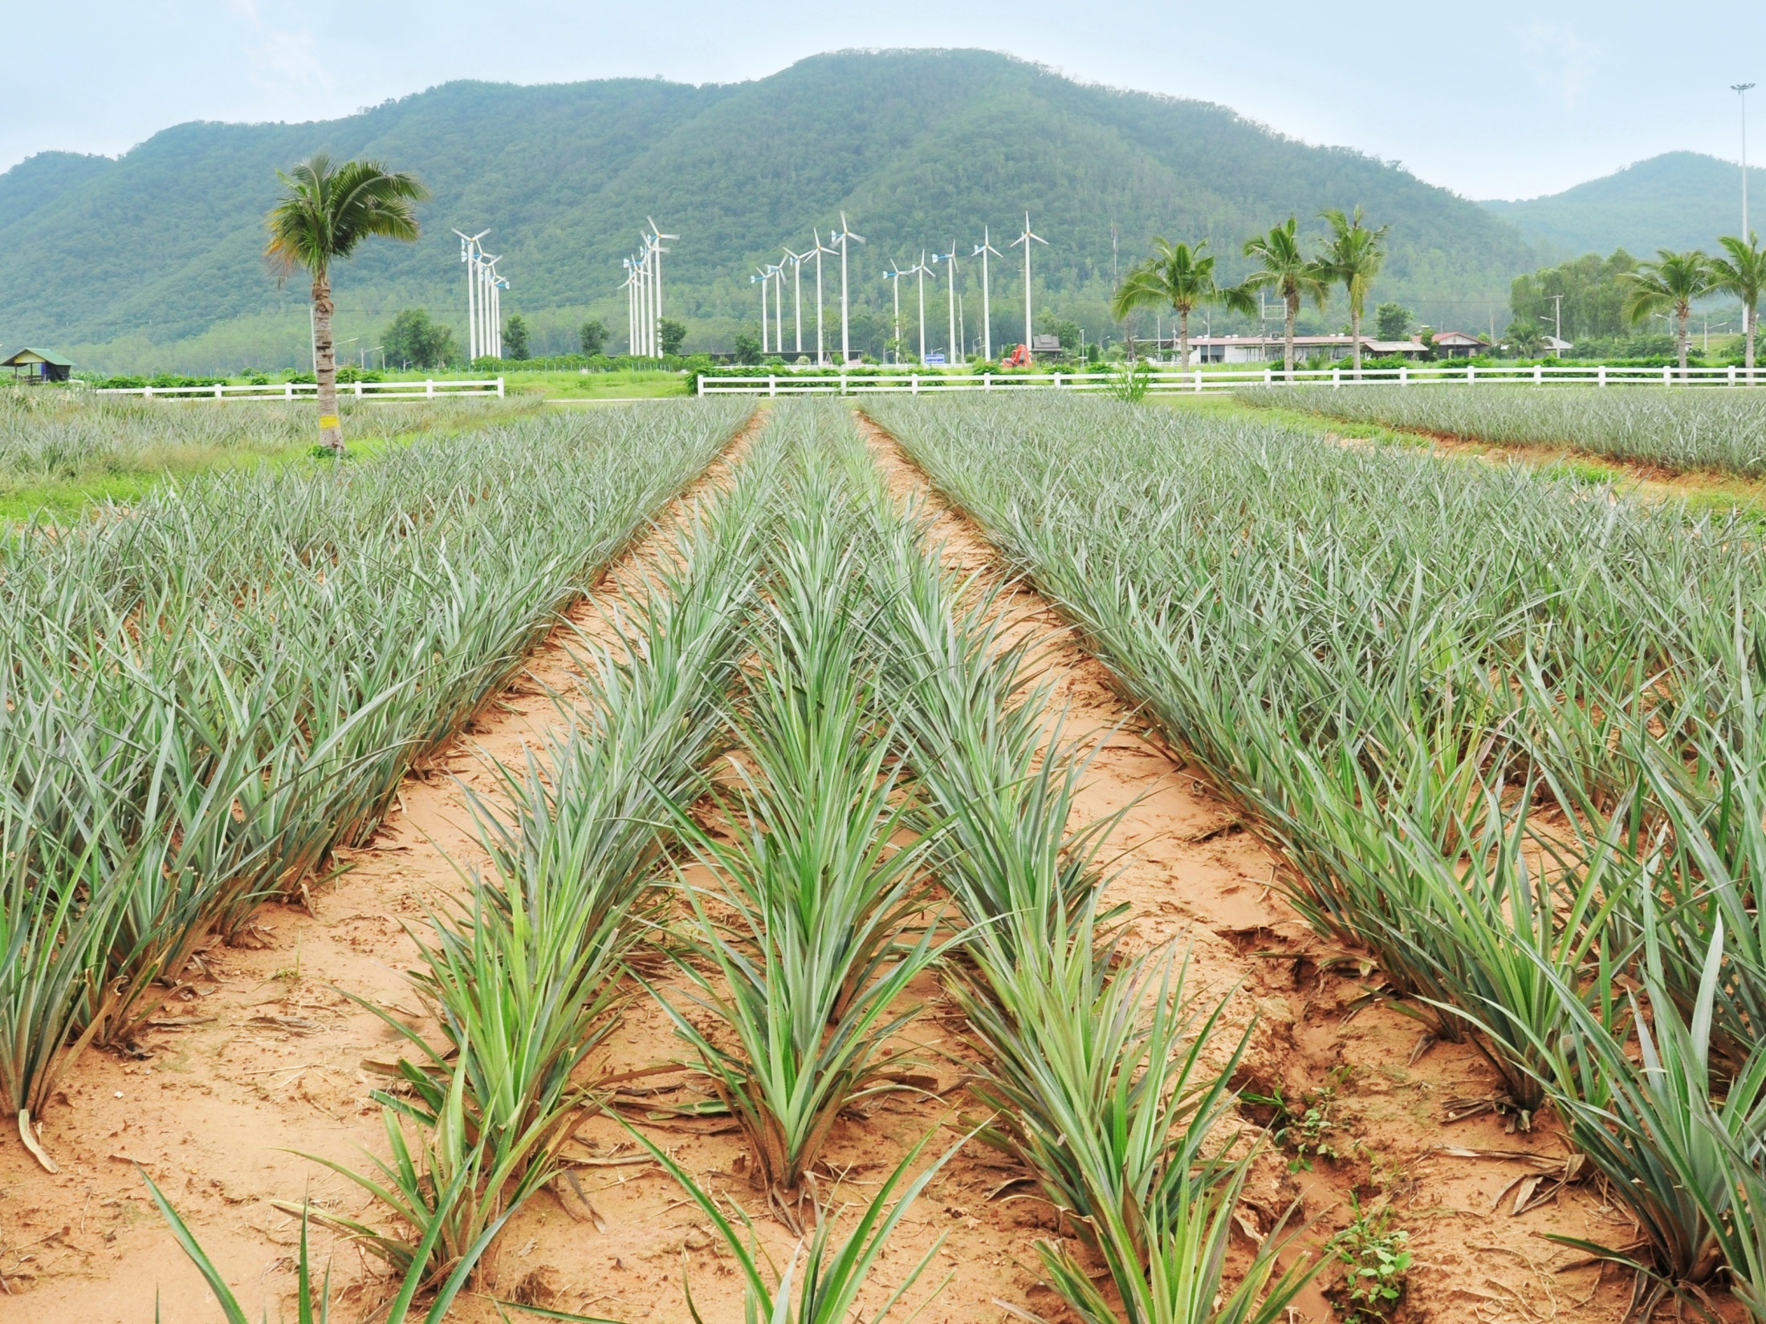
Key messages
Australia’s climate has already changed
Hotter since 1910
more rain in northern Australia since 1970s
less rain in south-east and south-west
Less snow
more extreme daily rain and fire weather
Sea level rise
iStock

Slide 4

Key messages
FURTHER INCREASES IN GREENHOUSE GASES WILL CAUSE MORE CLIMATE CHANGE
MORE HOT DAYS, FEWER COLD DAYS & LESS SNOW
DRIER IN THE SOUTH
MORE EXTREME DAILY RAIN AND FIRE WEATHER
SEA LEVEL RISE
OCEAN ACIDIFICATION
FEWER BUT MORE INTENSE TROPICAL CYCLONES
REAFFIRMS PREVIOUS PROJECTIONS BUT SOME UNCERTAINTIES REMAIN
iStock

Slide 5
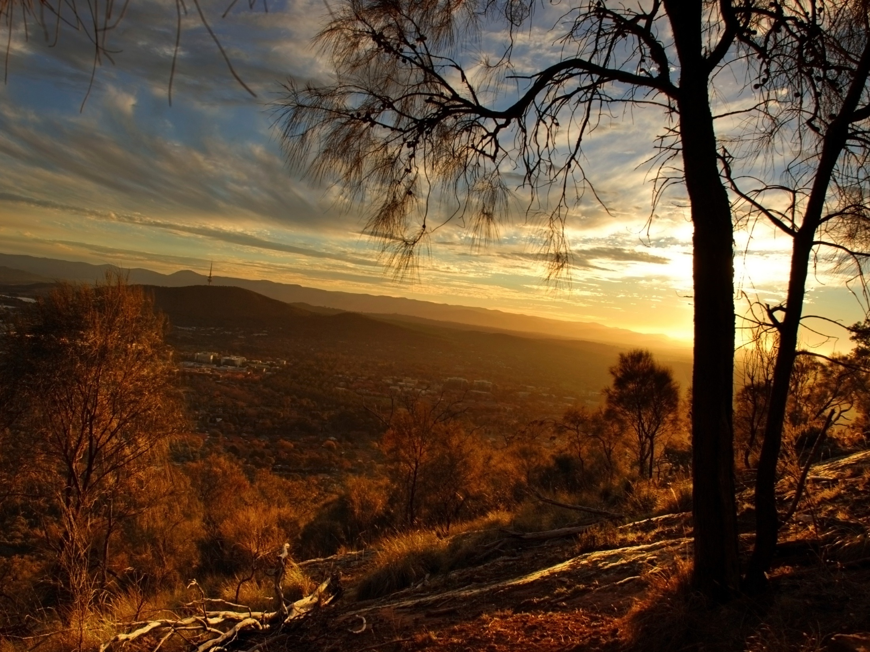
What’s new
In CCIA 2015?

Slide 6
Key elements of the projections project
Four emission scenarios and four time periods
Ranges of change for 21 climate variables based on 40 climate models
Addressing a range of user needs and building user capacity
Providing users with data and information for decision making

Slide 7
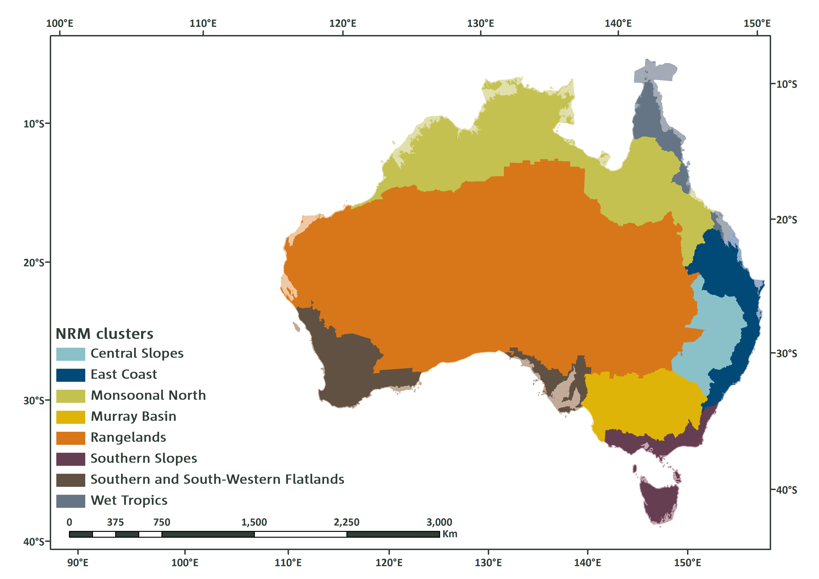
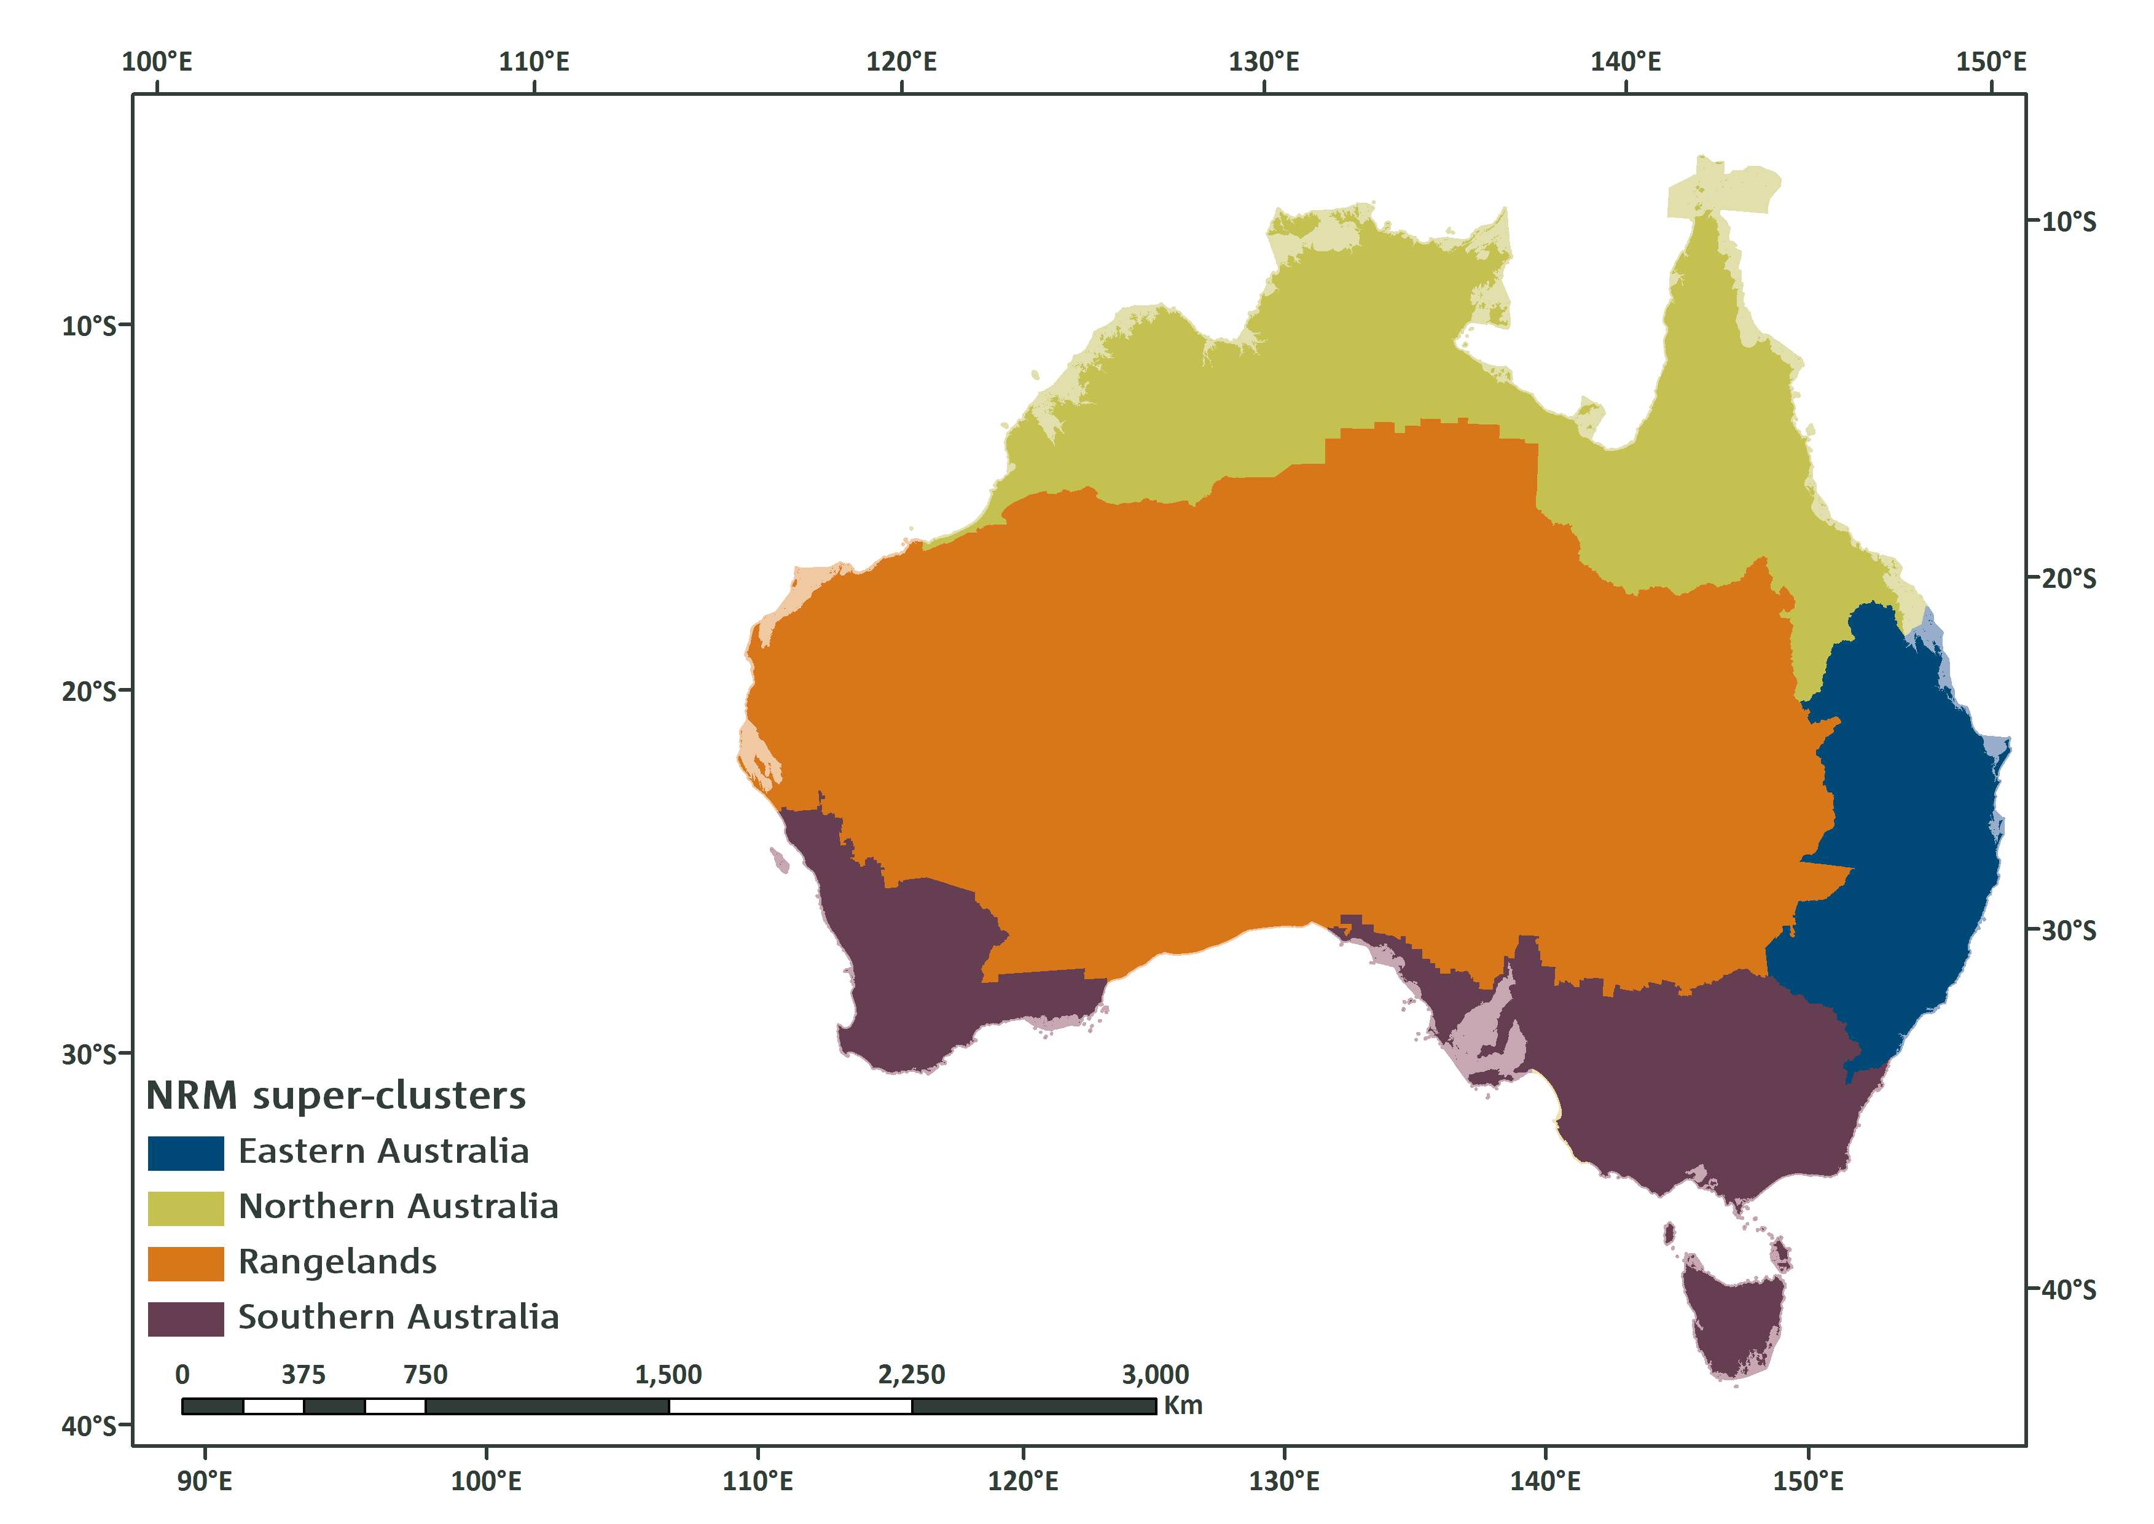
REGIONAL INFORMATION – super clusters
Notes:
Much more extensive regional analysis
Inclusion of regional sea level rise & extremes

Slide 8
REGIONAL INFORMATION - clusters
Notes:
Much more extensive regional analysis
Inclusion of regional sea level rise & extremes

Slide 9
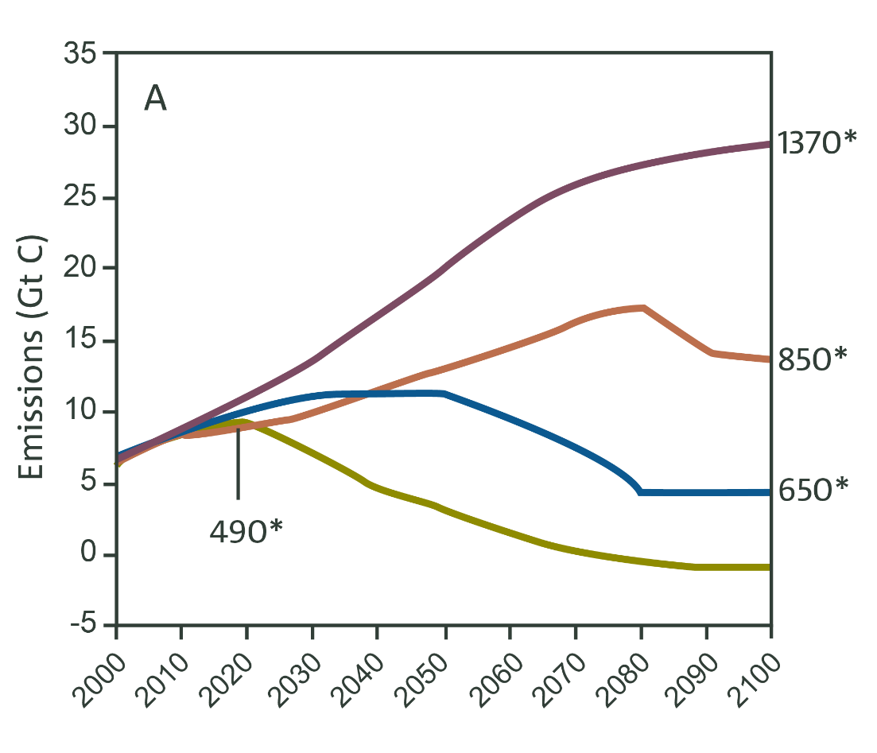
Greenhouse gas emissions &
Concentration pathways
Emissions scenarios
Concentration pathways
RCP8.5
RCP6
RCP4.5
RCP2.6
Notes:
Concentrations, parts per million

Slide 10
Assessing confidence in projections
Confidence assessment
Downscaling
Model evaluation
Process understanding
Observed trends
Climate model results
Notes:
More extensive model evaluation
Use of multiple lines of evidence to assess confidence in projections

Slide 11
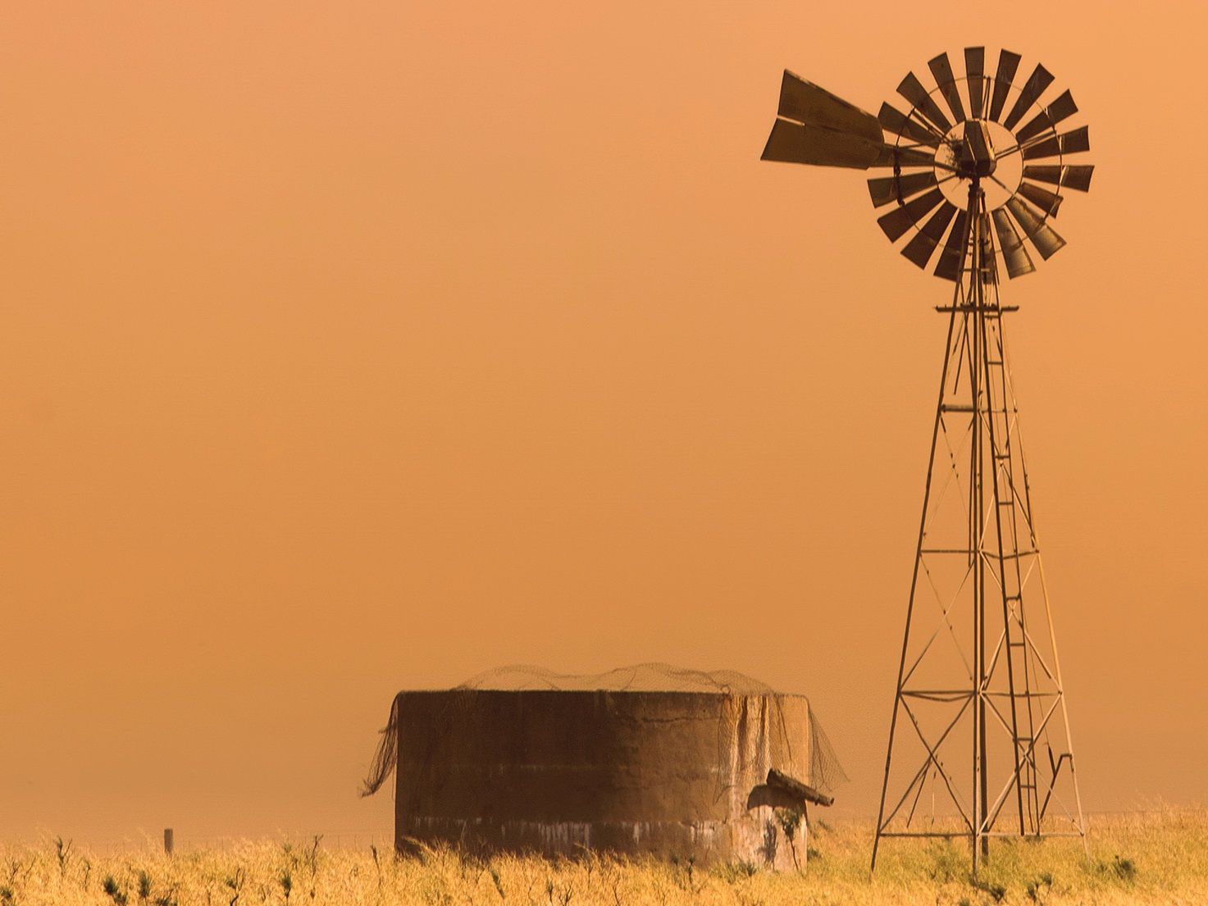

Temperature
Australia will warm substantially during the 21st century
iStock

Slide 12
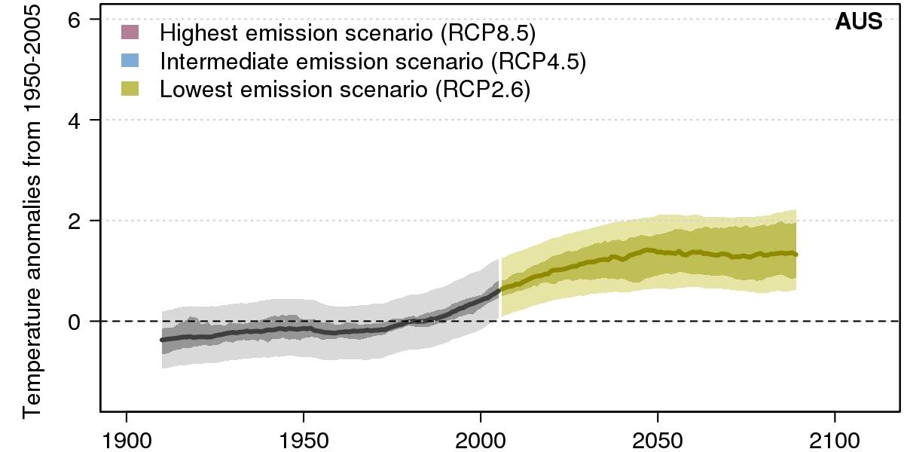
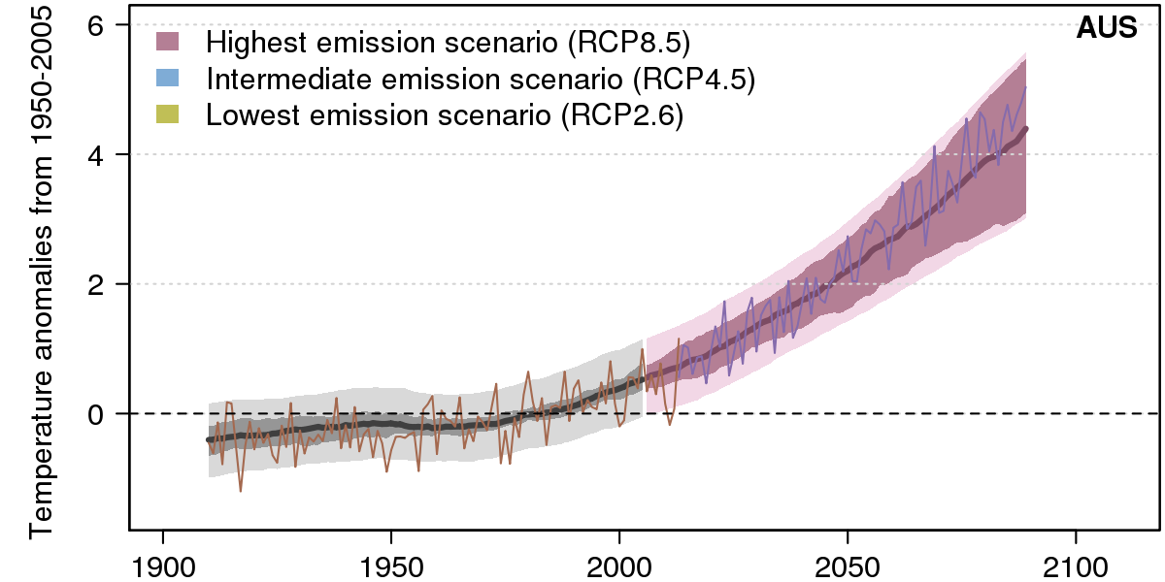
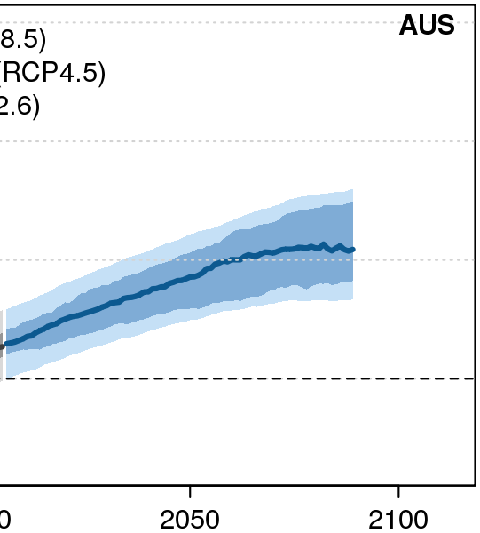
Australia will warm substantially during the 21st century
Notes:
See through?
Wipe reveal for each RCP
Keep all RCPS on one screen.

Slide 13
Australia will warm substantially during the 21st century
There is very high confidence in continued increases of mean, daily minimum and daily maximum temperatures throughout this century for all regions in Australia.
Warming will be large compared to natural variability in the near future (2030) (high confidence) and very large compared to natural variability late in the century (2090) under high emissions (very high confidence).
More frequent and hotter hot days (very high confidence).
Fewer frost days are projected (high confidence)

Slide 14
1.3 ← +1.7 ºC → 2.6
Temperature
INCREASE
2090
Rcp4.5
1.5 ← +2.1 ºC → 2.9
1.3
↑
+1.9 ºC
↓
2.6
1.2 ← +1.7 ºC → 2.1
Changes are relative to 1986-2005
Notes:
Talk about spatial variation
Not a lot of seasonal difference.

Slide 15
2.7 ← +3.7 ºC → 4.9
Temperature
INCREASE
2090
Rcp8.5
2.9 ← +4.3 ºC → 5.3
2.8
↑
+3.9 ºC
↓
5.0
2.7 ← +3.5 ºC → 4.2
Changes are relative to 1986-2005
Notes:
Talk about spatial variation
Not a lot of seasonal difference.

Slide 16

DARWIN
+ 100 days
Hot days
Days over 35 ºC
2090 / RCP4.5
CAIRNS
+ 8 days
ALICE SPRINGS
+ 39 days
SYDNEY
+ 3 days
PERTH
+ 15 days
ADELAIDE
+ 12 days
MELBOURNE
+ 5 days
Changes are relative to 1986-2005
Notes:
Talk about spatial variation
Not a lot of seasonal difference.

Slide 17
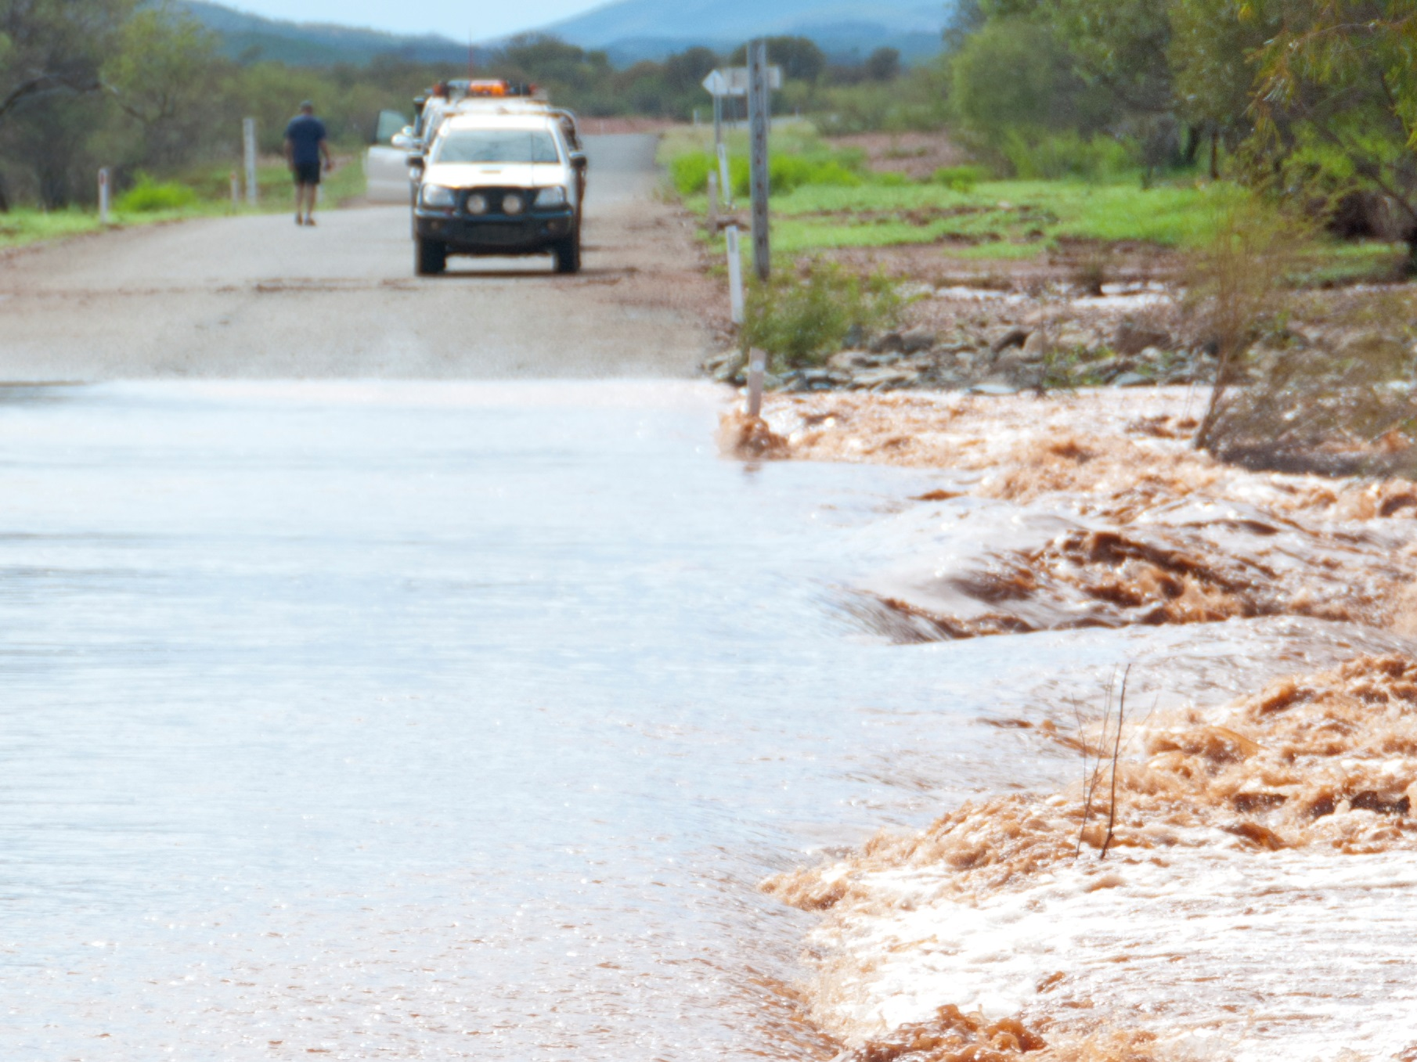

RAINFALL
WINTER/SPRING RAINFALL IS PROJECTED TO DECLINE IN SOUTHERN AUSTRALIA
INCREASES OR DECREASES ARE POSSIBLE ELSEWHERE & IN OTHER SEASONS
iStock

Slide 18
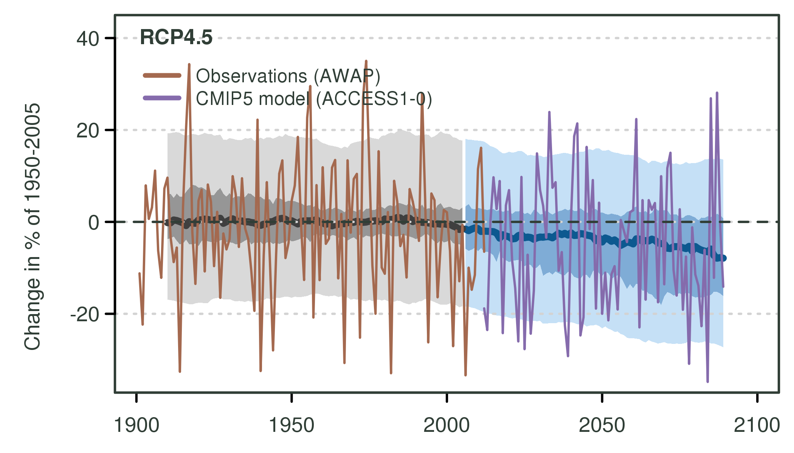
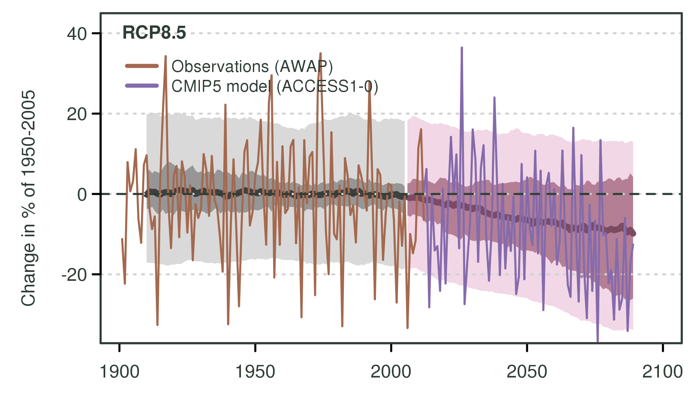
SOUTHERN AUSTRALIA
RAINFALL
Variability
Versus
change

Slide 19
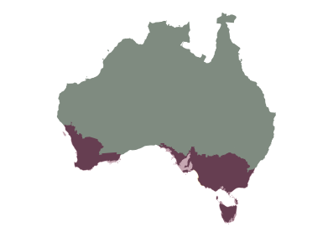
Winter and spring rainfall is projected to decrease (high confidence), though increases are projected for Tasmania in winter (medium confidence).
The direction of change in summer and autumn rainfall in southern Australia cannot be reliably projected, but there is medium confidence in a decrease in south-western Victoria in autumn and in western Tasmania in summer.
southern australia
Range of change in % for 2090 | Summer | Autumn | Winter | Spring
RCP4.5 | -13 to +8 | -19 to +9 | -19 to +2 | -23 to 0
RCP8.5 | -13 to +16 | -25 to +13 | -32 to -2 | -44 to -3

Slide 20
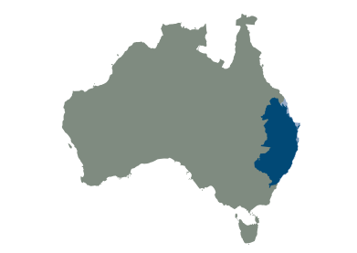
High confidence that in the near future (2030) natural variability will predominate over trends due to greenhouse gas emissions.
For late in the century (2090), there is medium confidence in a winter rainfall decrease. Other seasons have strongly contrasting results from climate models and downscaling.
EASTern australia
Range of change in % for 2090 | Summer | Autumn | Winter | Spring
RCP4.5 | -15 to +13 | -28 to +18 | -25 to +8 | -27 to +9
RCP8.5 | -16 to +28 | -33 to +26 | -40 to +7 | -41 to +8

Slide 21
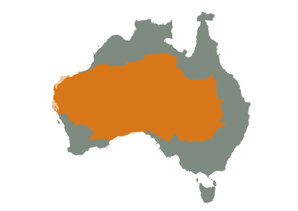
High confidence that natural climate variability will remain the major driver of rainfall changes until 2030 .
By 2090, decreases in winter rainfall are projected for the southern Rangelands with high confidence.
Rangelands
Range of change in % for 2090 | Summer | Autumn | Winter | Spring
RCP4.5 | -16 to +10 | -23 to +27 | -34 to +7 | -26 to +11
RCP8.5 | -22 to +25 | -42 to +32 | -50 to +18 | -50 to +23

Slide 22
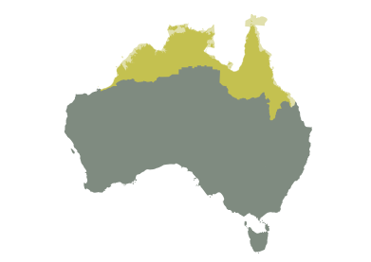
There is high confidence that in the near future (2030), natural variability will predominate over trends due to greenhouse gas emissions.
There is low confidence in the direction of future rainfall change by late in the century (2090), but substantial changes to wet-season and annual rainfall cannot be ruled out.
Northern australia
Range of change in % for 2090 | Summer | Autumn | Winter | Spring
RCP4.5 | -18 to +8 | -17 to +12 | SEASONALLY DRY | -32 to +27
RCP8.5 | -24 to + 18 | -30 to +26 | SEASONALLY DRY | -44 to +43

Slide 23
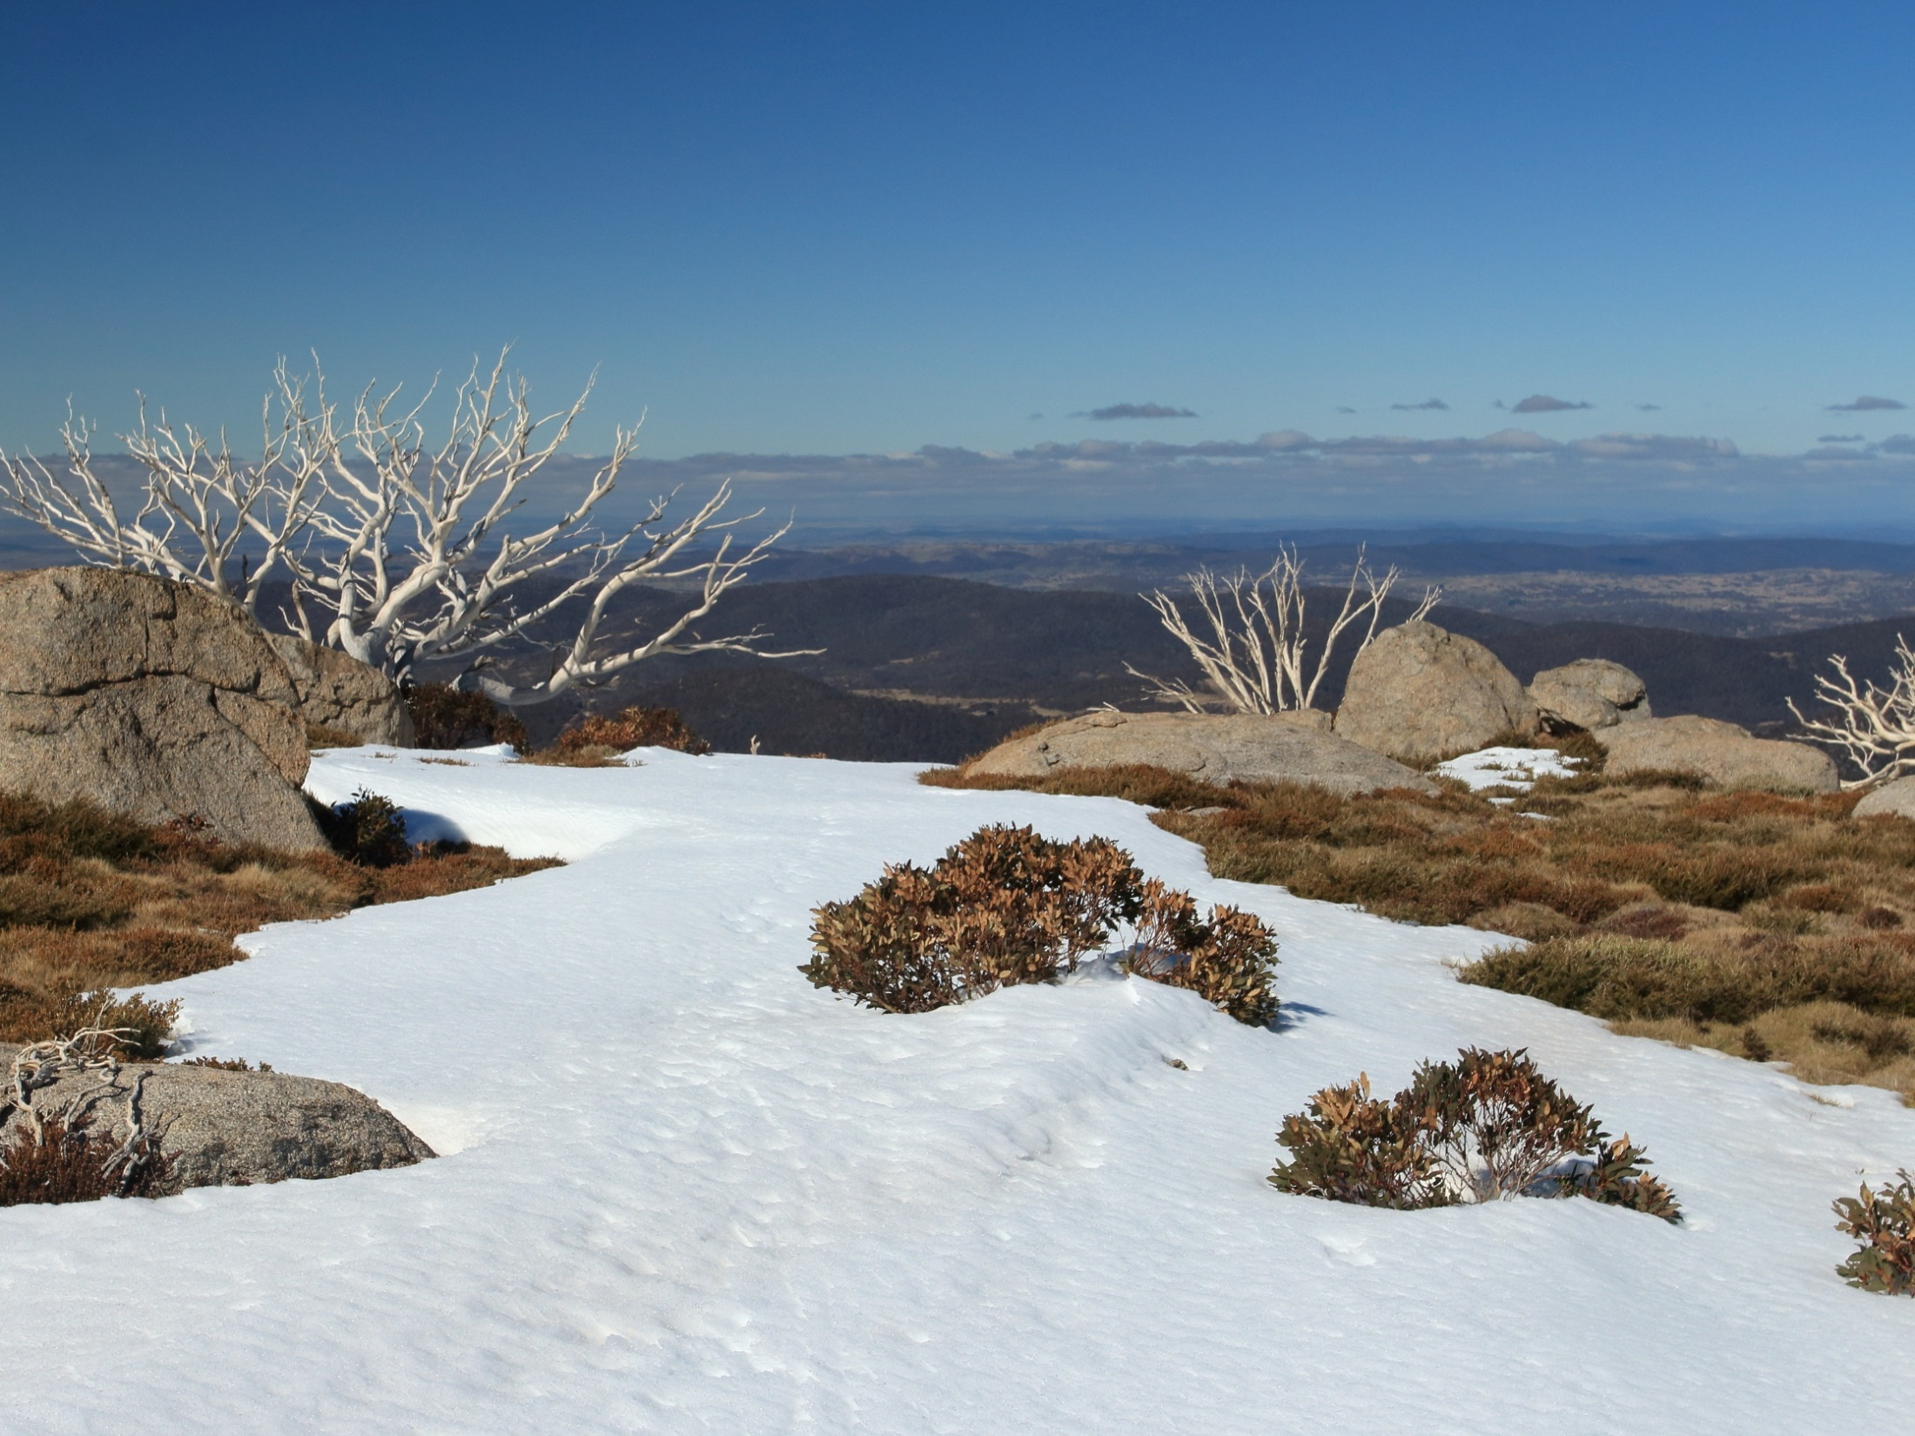

Snowfall in the Australian Alps is projected to decrease, especially at low elevations
Snow

Slide 24

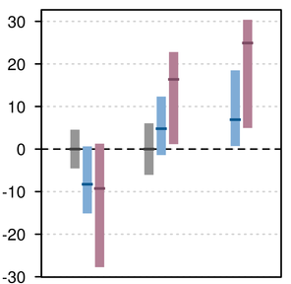

Extreme rainfall
Throughout most of Australia, extreme rainfall events (wettest day of the year and wettest day in 20 years) are projected to increase in intensity with high confidence
% change by 2090
ANNUAL
WETTEST
DAY IN
20 YEARS
WETTEST
DAY OF
THE
YEAR
Southern Australia

Slide 25
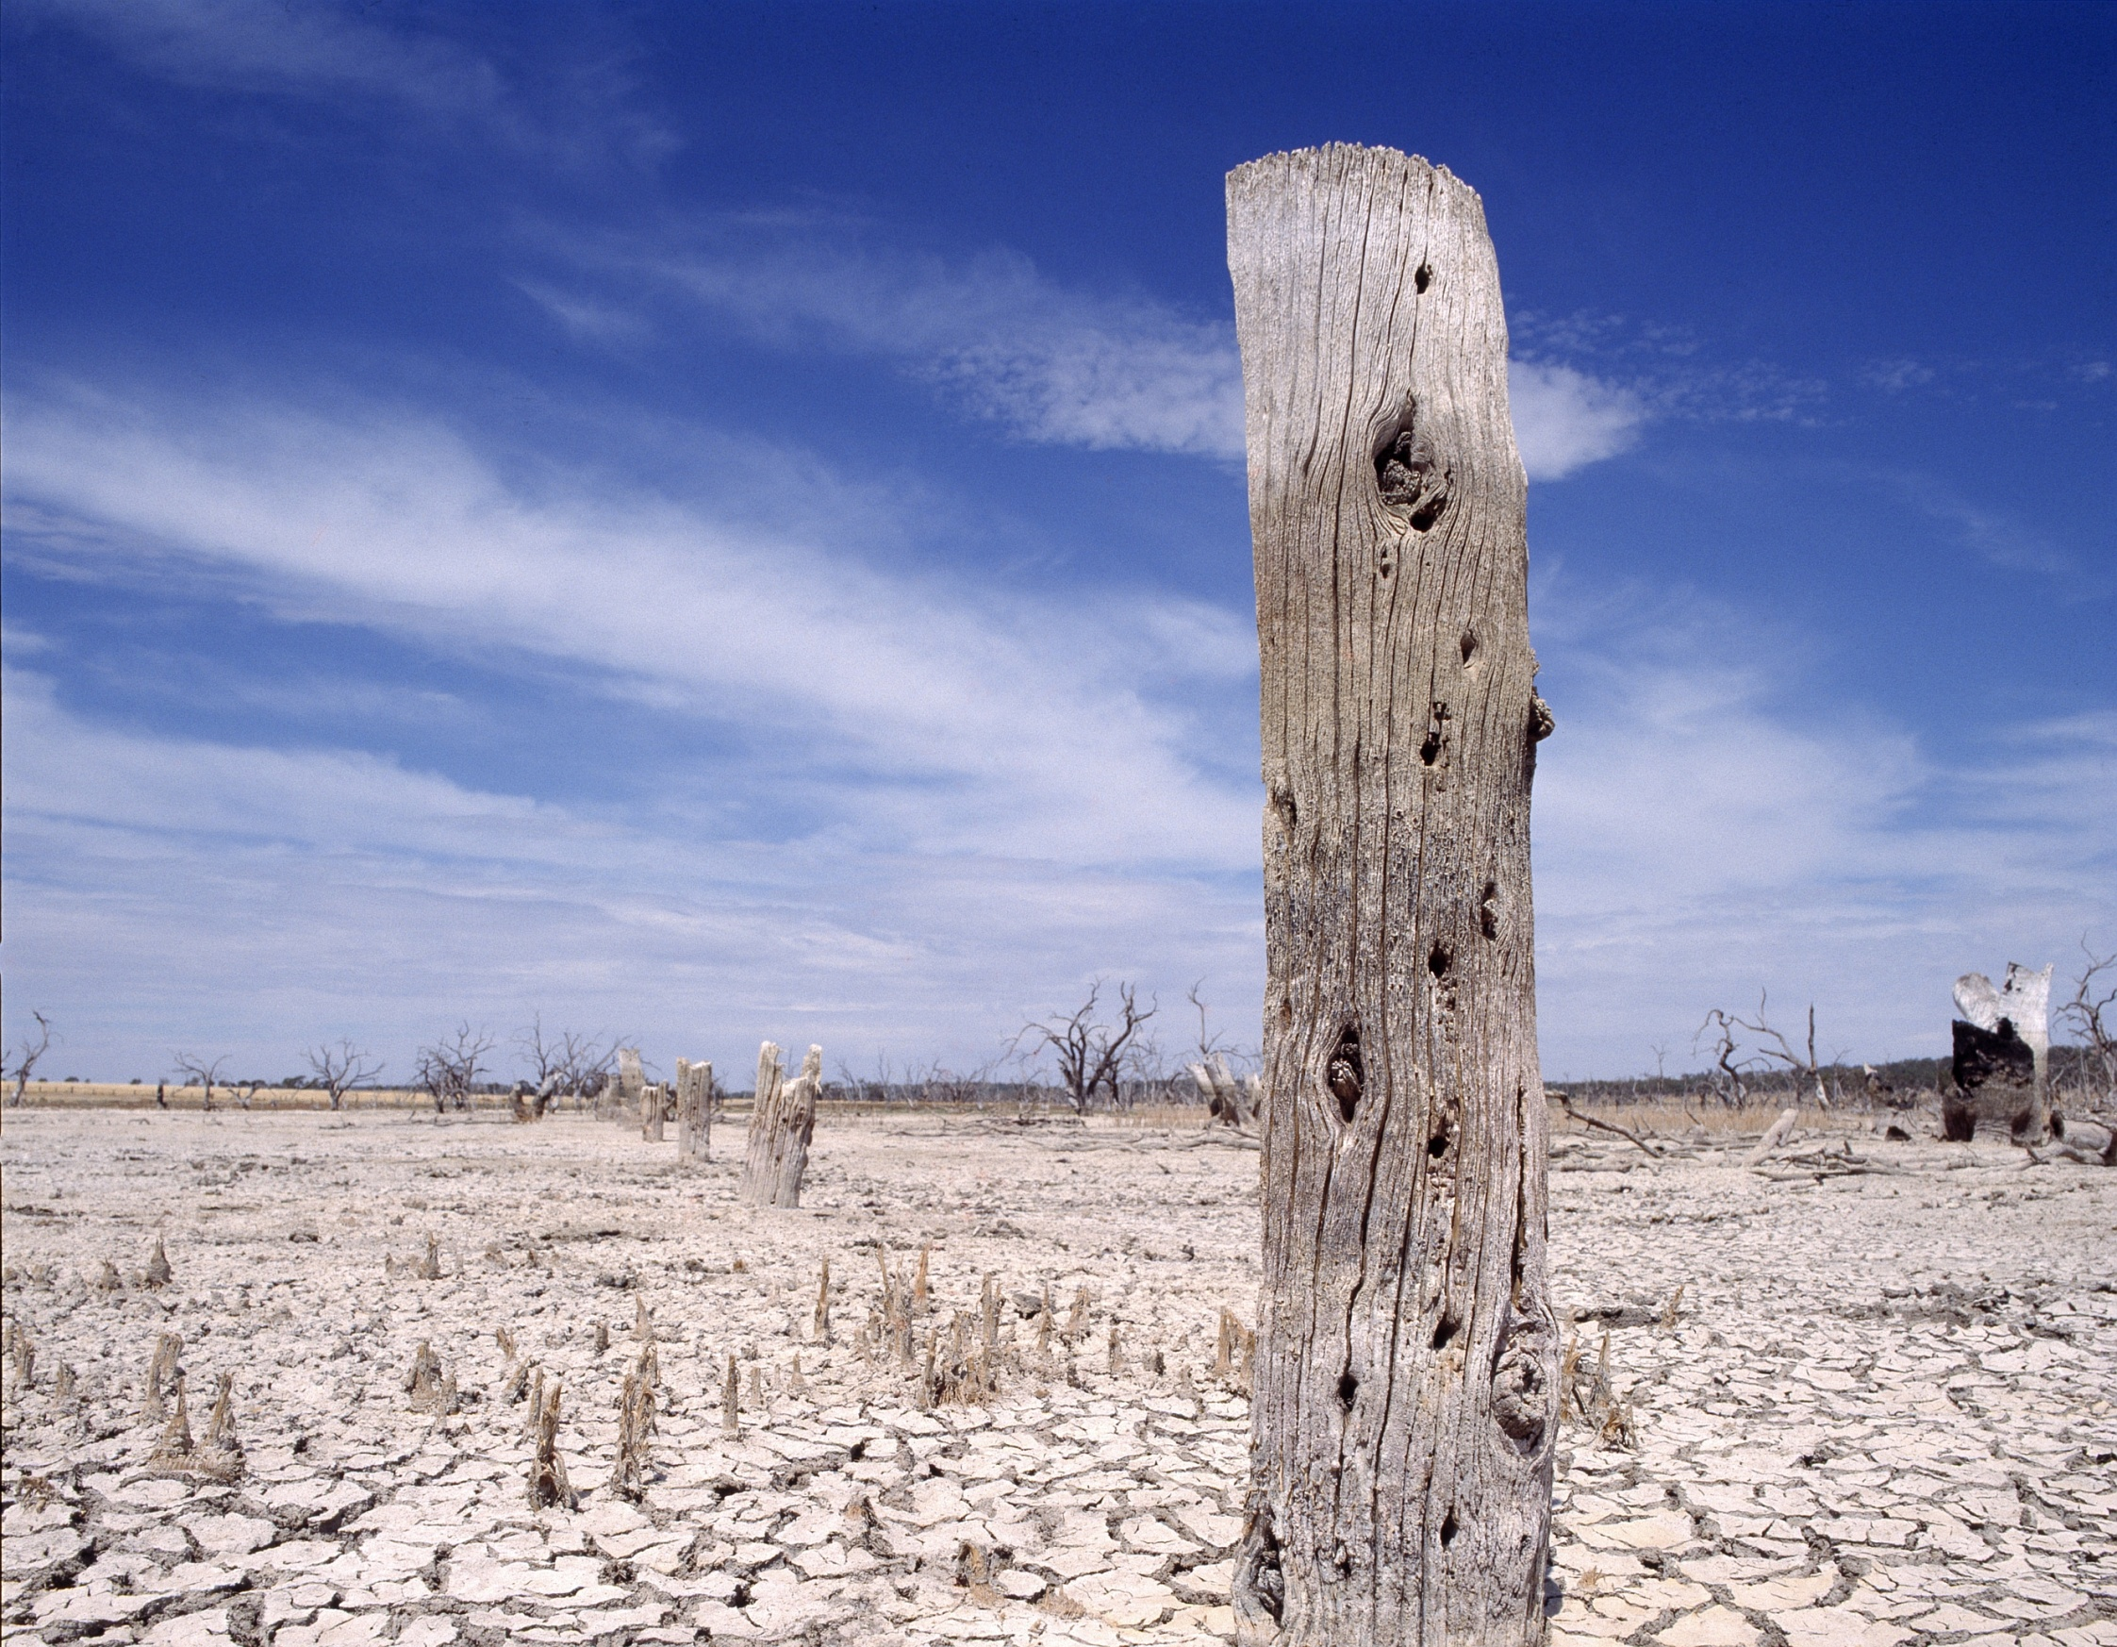

drought
Time in drought is projected to increase in southern Australia
higher evaporation rates
CSIRO

Slide 26
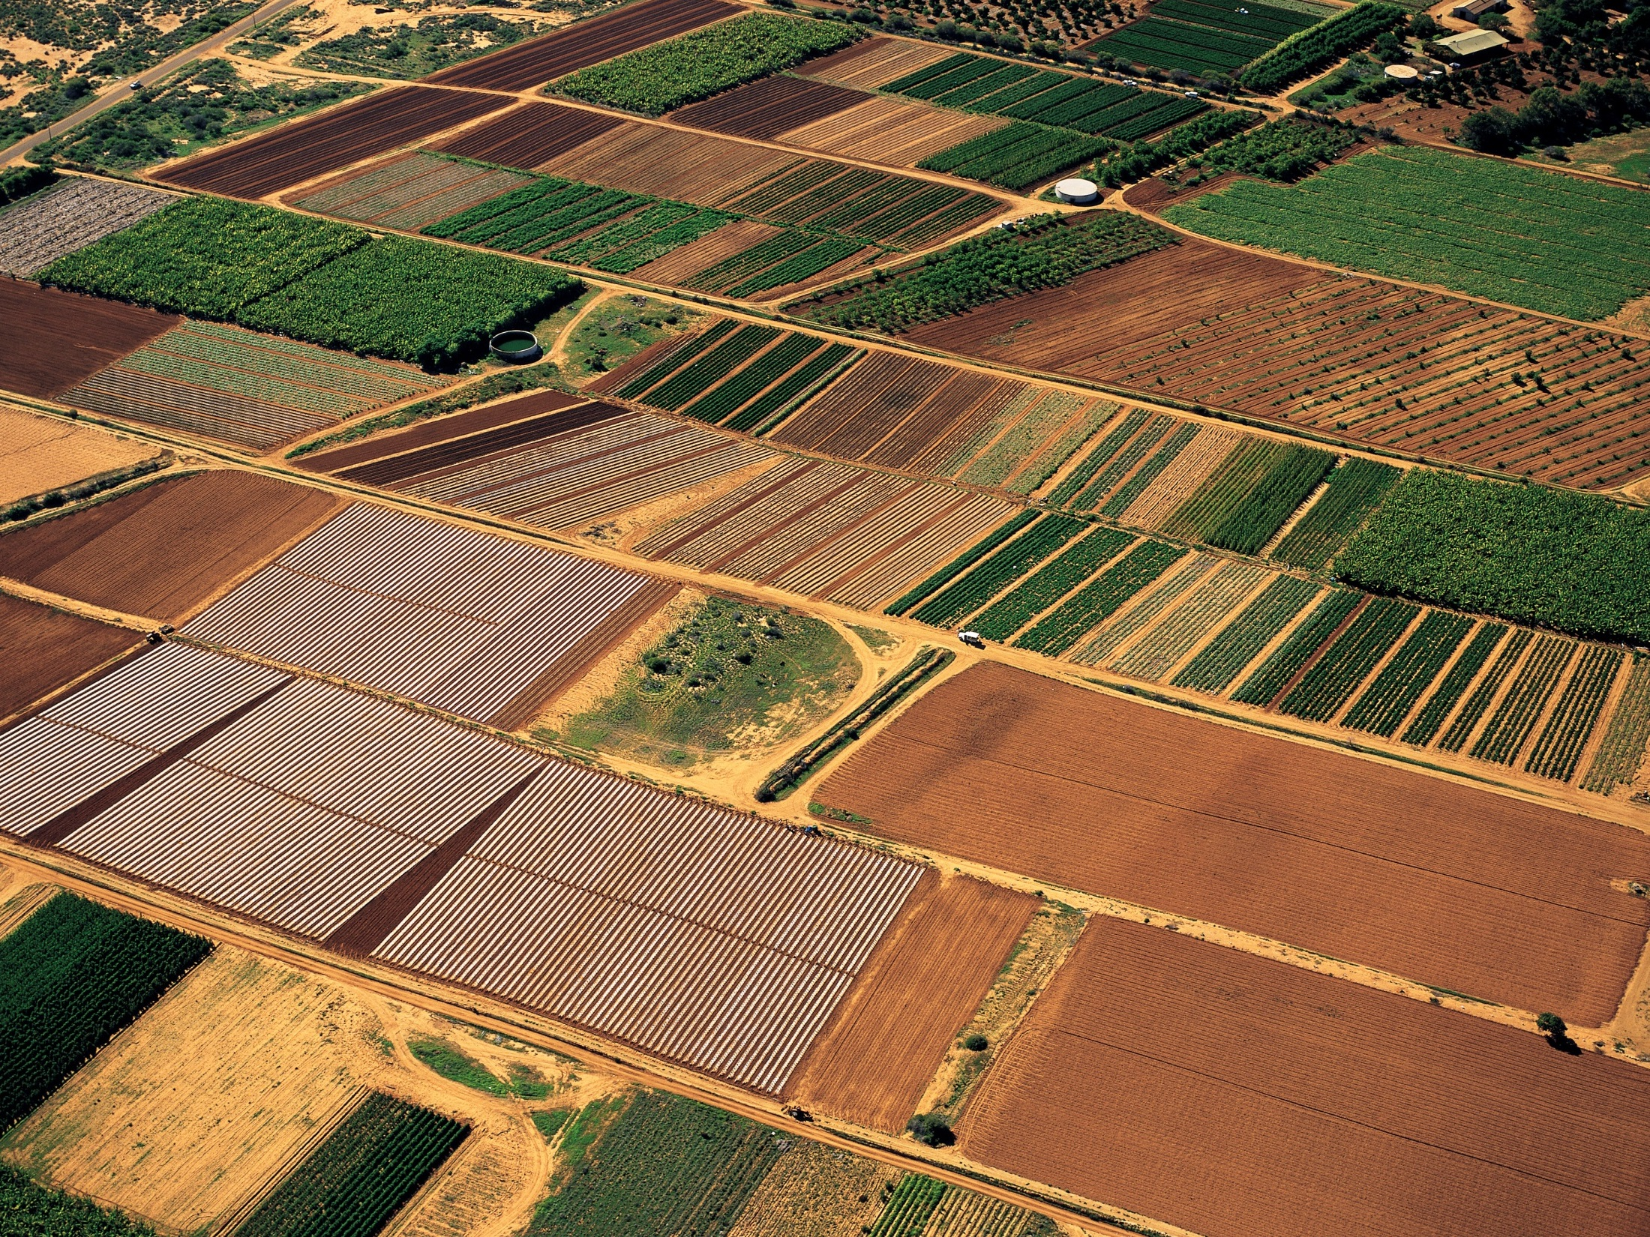

Soil moisture
THERE IS HIGH CONFIDENCE IN DECREASING SOIL MOISTURE IN THE SOUTHERN REGIONS (PARTICULARLY IN WINTER AND SPRING) AND MEDIUM CONFIDENCE IN DECREASING SOIL MOISTURE ELSEWHERE.
iStock

Slide 27
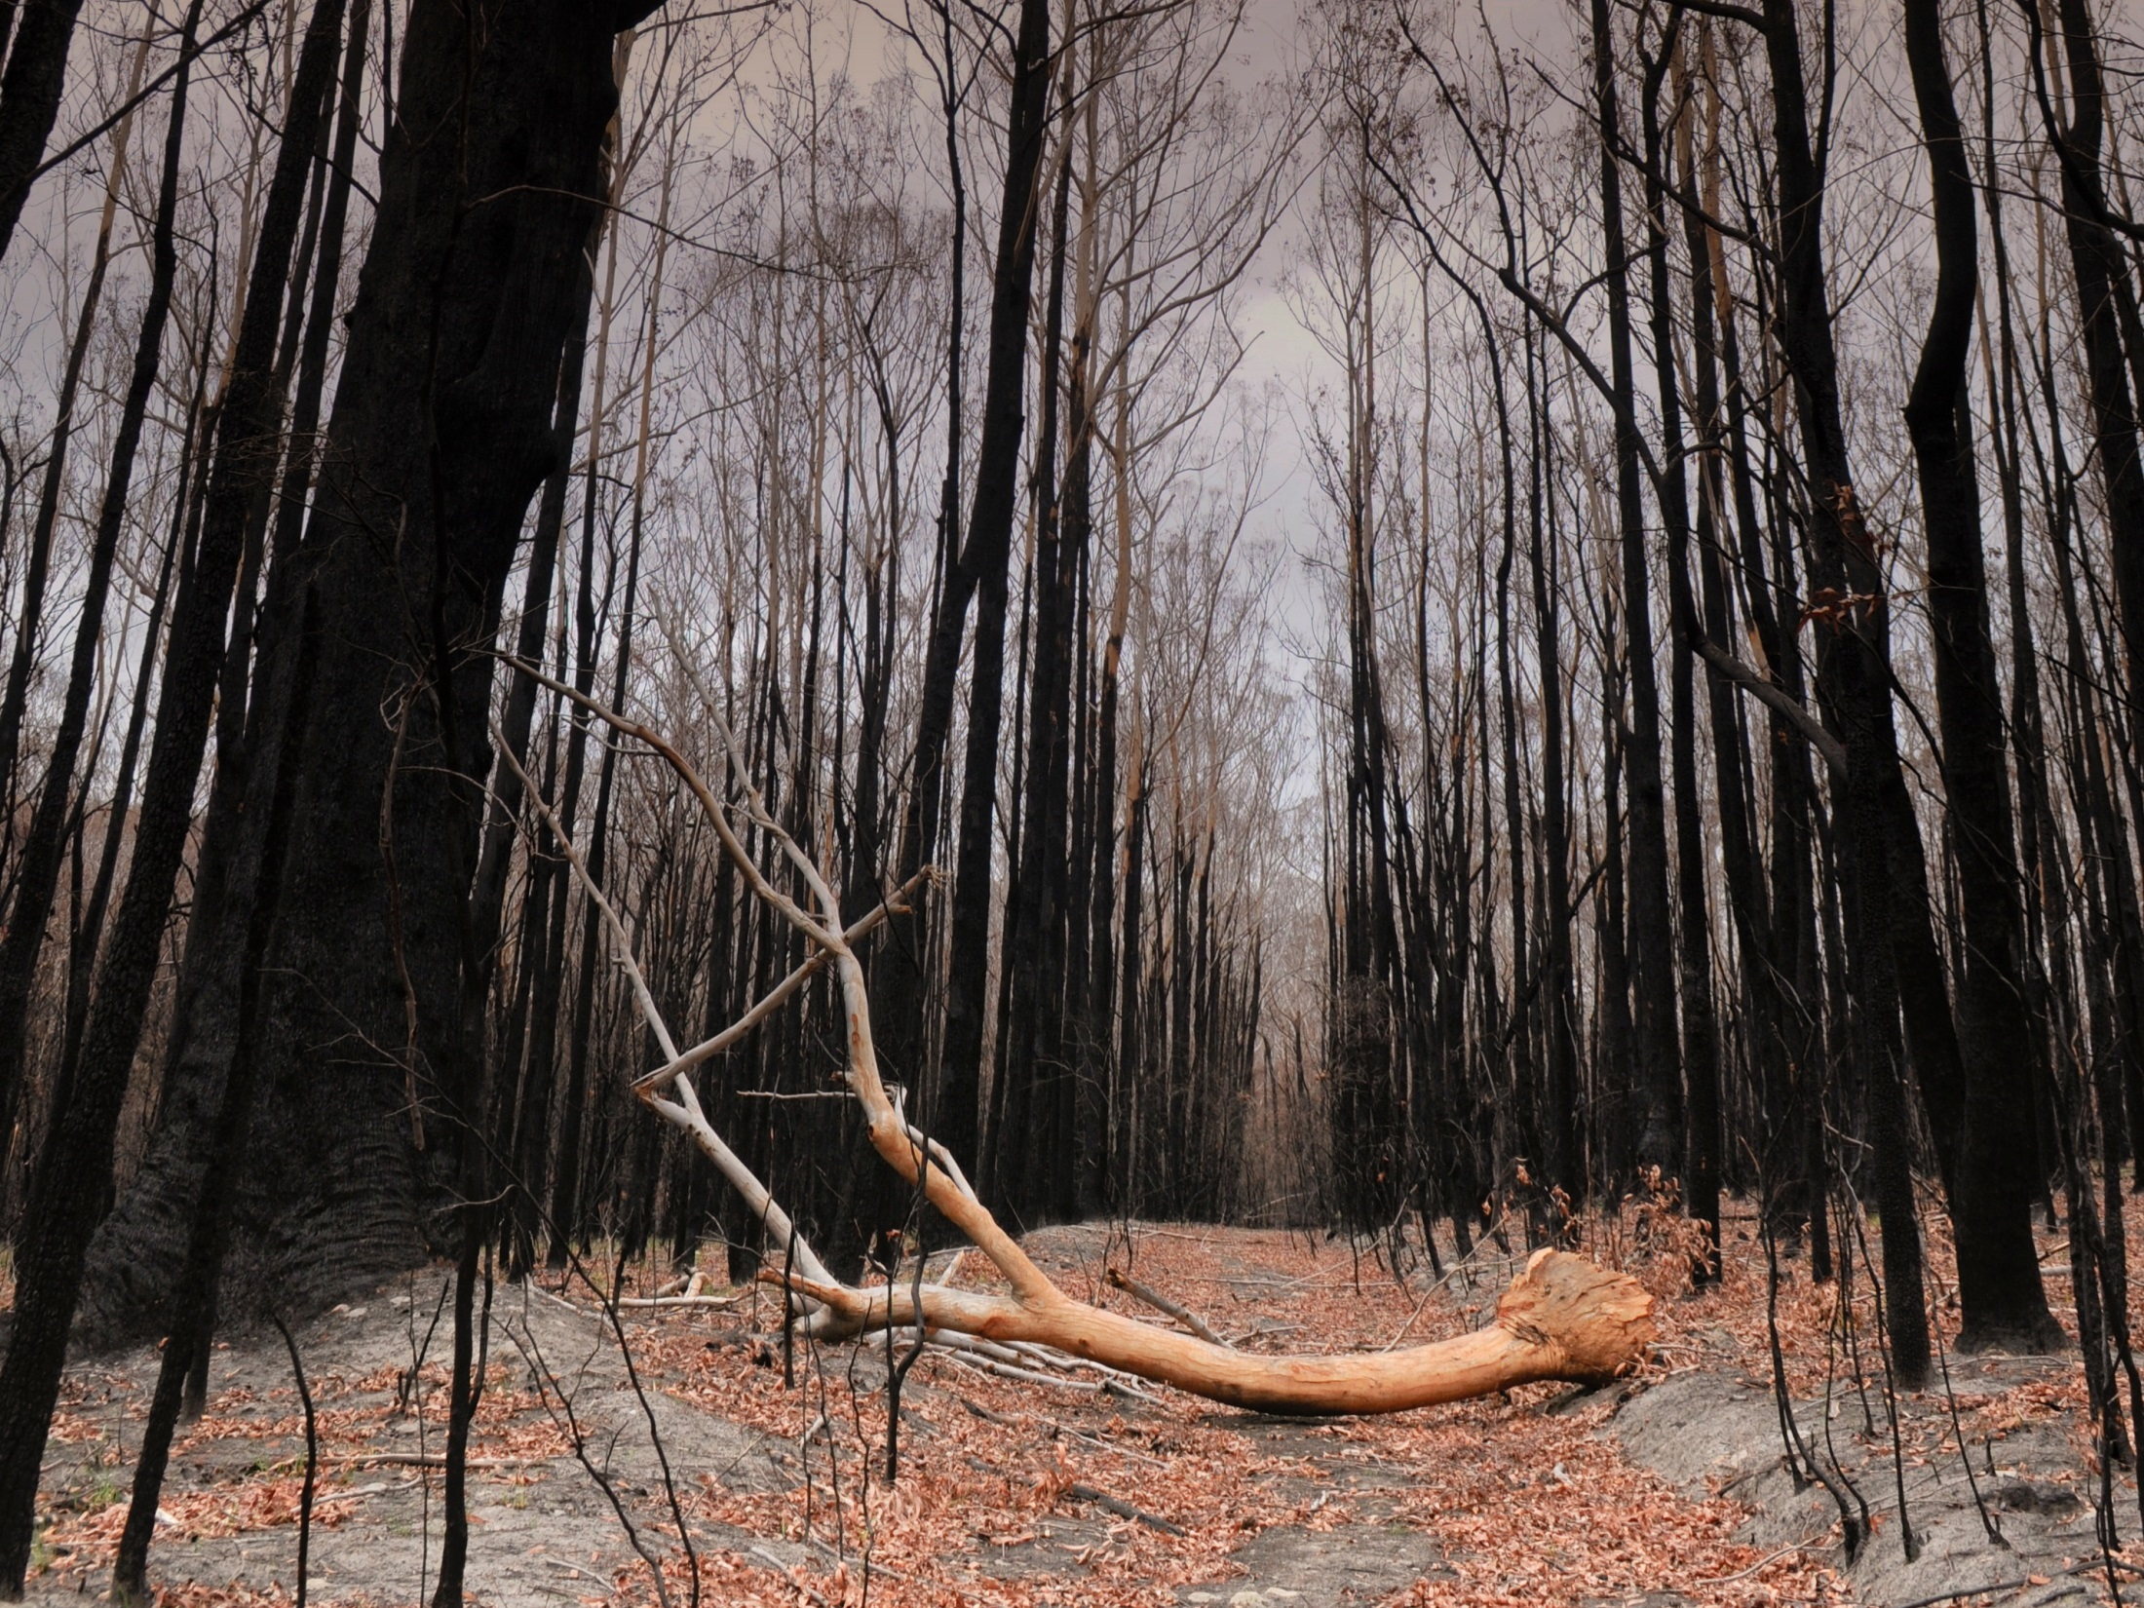

Southern and eastern Australia
are projected to experience
harsher fire weather
changes elsewhere are
less certain
Fire weather
iStock

Slide 28
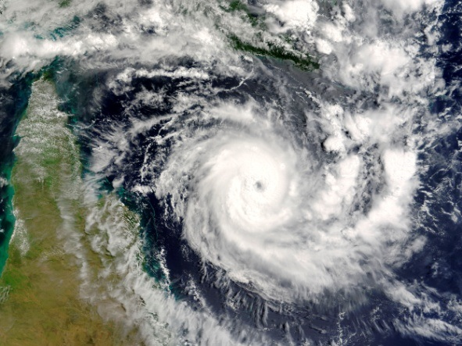

Tropical cyclones are projected to become less frequent with a greater proportion of high intensity storms (stronger winds and greater rainfall) (medium confidence). A greater proportion of storms may reach south of 25 degrees South (low confidence)
Tropical cyclones
Offset
Notes:
Change map to be just Eastern Australia – in Blue!

Slide 29
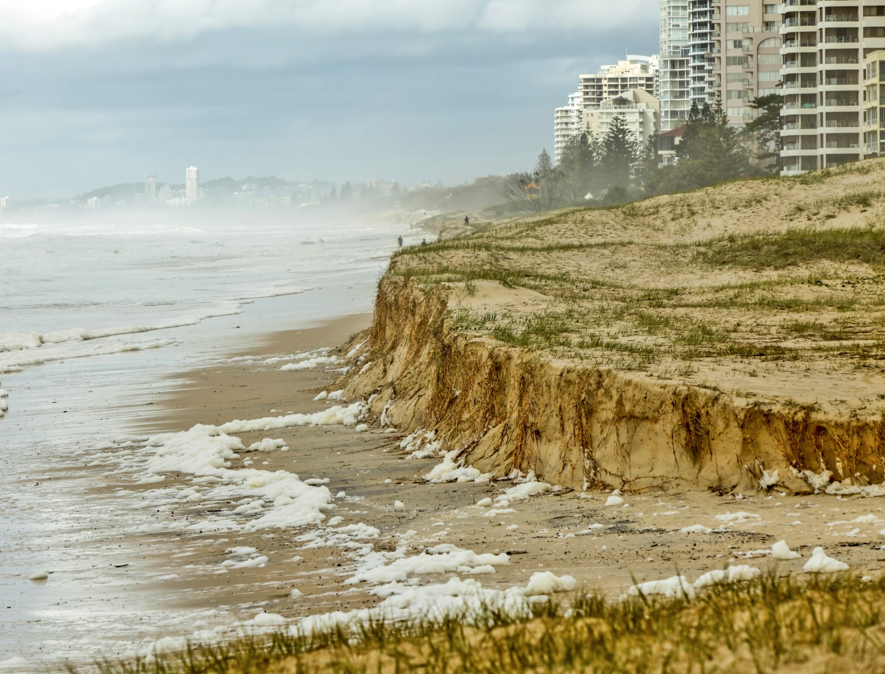

Sea level rise
Sea levels will continue to rise throughout the 21st century
and beyond
Extreme sea levels will also rise
iStock

Slide 30
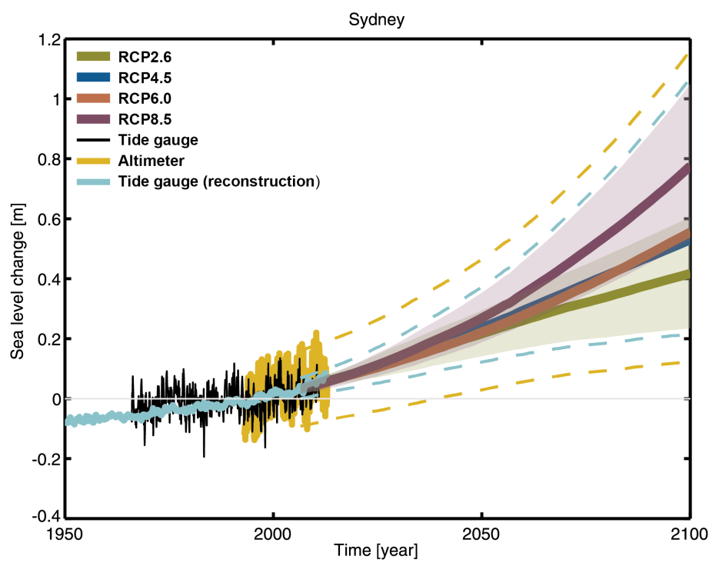
In line with global mean sea level, Australian sea levels are projected to rise through the 21st century (very high confidence), and are very likely to rise at a faster rate during the 21st century than over the past four decades, or the 20th century as a whole, for the range of RCPs considered (high confidence)
Sea level rise
Changes are relative to 1986-2005
Notes:
Change map to be just Eastern Australia – in Blue!

Slide 31
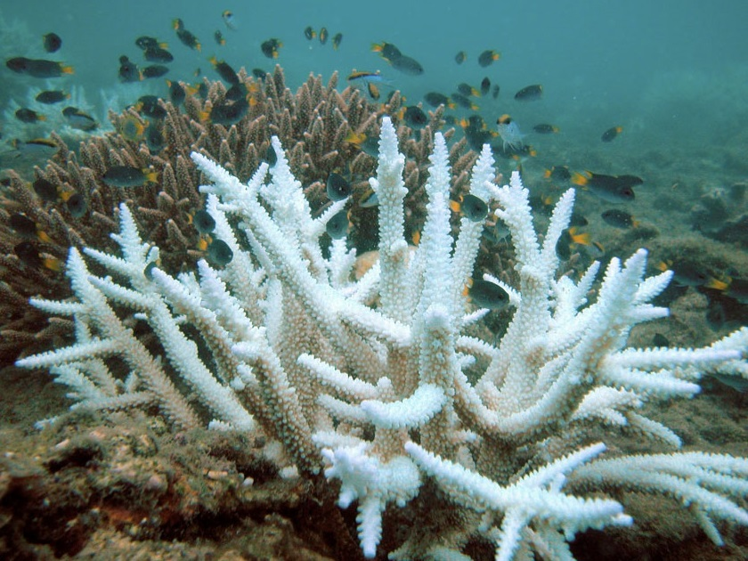
There is very high confidence that sea surface temperatures around Australia will rise.
There is very high confidence that around Australia the ocean will become more acidic.
There is medium confidence that long-term viability of corals will be impacted, and that there will be harm to marine ecosystems.
Sea surface temperature and
acidification
Wikipedia/Acropora

Slide 32
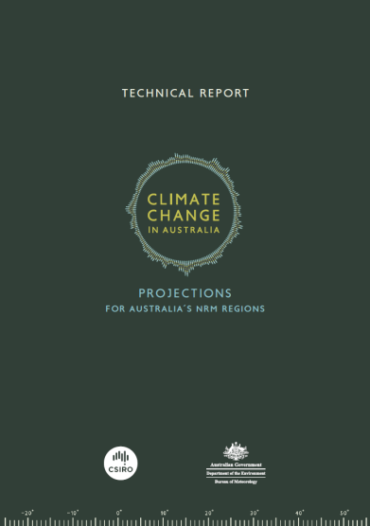
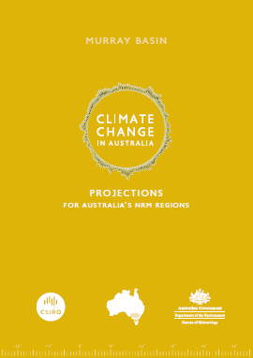
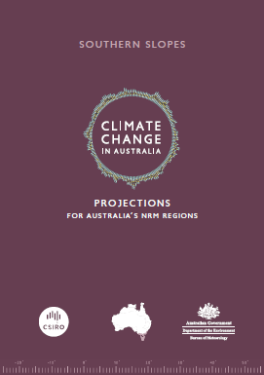
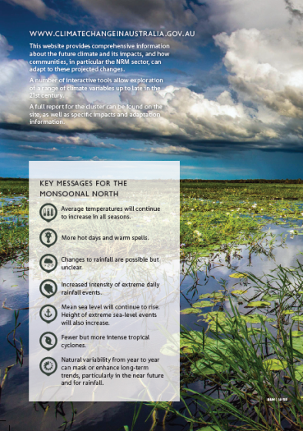
communication – reports / brochures
Peer-reviewed journal papers
Technical Report
  The underpinning science behind all projections
8 x Cluster Reports
  Focus on regional areas with distinct future climates
8 x Cluster Brochures
  Easy to understand key messages about regional climate change
Website: www.climatechangeinaustralia.gov.au

