Slide 1
Electricity Sector Climate Information Project (ESCI): Overview
Notes:
‘Why and how the industry should use the outputs of the project’

Slide 2
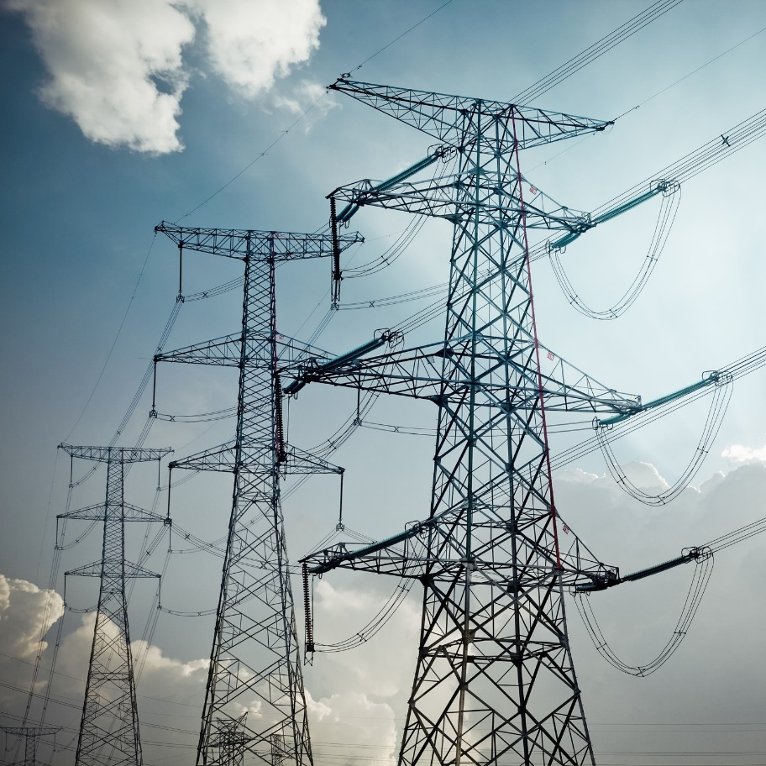
Challenges to electricity sector resilience
Power system resilience is the ability to withstand and rapidly recover from the effects of a hazard.
Challenges to resilience include:
Extreme weather such as heatwaves, wind storms, fires and floods
Variability in weather and climate
Climate change
Notes:
Image to be replaced. It’s from https://www.newcastle.edu.au/__data/assets/image/0016/447010/PHD_power.jpg

Slide 3
Climate change and the electricity sector
Climate change – energy systems face numerous challenges in a changing climate. Increasingly, energy system vulnerabilities to heightened climate impacts, particularly extreme weather, are recognised as material risks to individual assets, the integrated energy system, and society. Consumer demand for energy, and increasingly generation supply, are significantly influenced by weather, increasing the power system’s climate exposure.
AEMO, 2020 ISP Appendix 8. Resilience and Climate Change

Slide 4
The climate change challenge

Slide 5
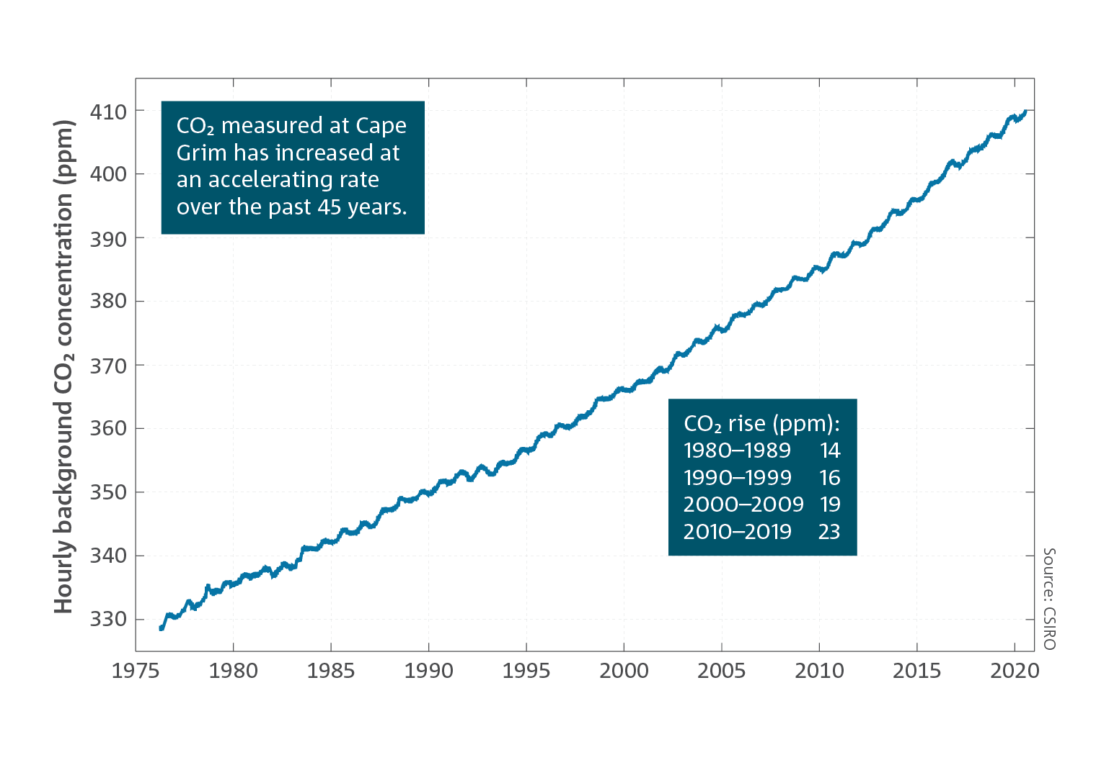
Greenhouse gas concentrations continue to rise
Global concentrations of all major long-lived greenhouse gases continue to rise.
Global annual mean carbon dioxide concentration reached 410 parts per million in 2019.
The rate of CO2 accumulation in the atmosphere has increased with every passing decade since atmospheric measurements began.
Notes:
Source: State of the Climate 2020 https://www.csiro.au/en/Showcase/state-of-the-climate
Version with no animation
Background hourly clean-air CO2 as measured at the Cape Grim Baseline Air Pollution Station from 1976 through to June 2020. The hourly data represent thousands of individual measurements. To obtain clean air measurements, the data are filtered to include only periods when air has come across the Southern Ocean and is thus free from local sources of pollution. The increase in CO2 concentration for each decade from 1980 to 2019 (1 January for the start year and 31 December for the end year) is also shown.

Slide 6
Greenhouse gas concentrations continue to rise
Global concentrations of all major long-lived greenhouse gases continue to rise.
Global annual mean carbon dioxide concentration reached 410 parts per million in 2019.
The rate of CO2 accumulation in the atmosphere has increased with every passing decade since atmospheric measurements began.
Notes:
Source: State of the Climate 2020 https://www.csiro.au/en/Showcase/state-of-the-climate
Version with animation
Background hourly clean-air CO2 as measured at the Cape Grim Baseline Air Pollution Station from 1976 through to June 2020. The hourly data represent thousands of individual measurements. To obtain clean air measurements, the data are filtered to include only periods when air has come across the Southern Ocean and is thus free from local sources of pollution. The increase in CO2 concentration for each decade from 1980 to 2019 (1 January for the start year and 31 December for the end year) is also shown.

Slide 7
Australia is getting warmer
Australia’s climate has warmed on average by 1.44 ± 0.24 °C since national records began in 1910
The frequency of extreme heat events is also rising
Notes:
Source: State of the Climate 2020 https://www.csiro.au/en/Showcase/state-of-the-climate

Slide 8
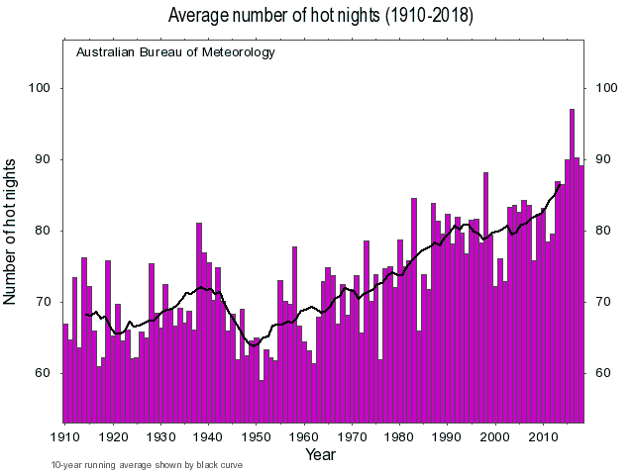
Increase in extreme temperatures and more hot nights
Greater frequency of very hot days in summer compared to earlier decades
National daily average maximum temperatures: 33 days exceeded 39 °C in 2019, more than the number observed from 1960 to 2018 combined (24 days).
Notes:
Key message:
Extreme heat has become more frequent
Notes on slide content:
This graph shows the annual number of nights with a minimum temperature greater than 20 degrees C.
The black line is the 10-year running average.
Customisation:
Updated plots are available from the Bureau of Meteorology website at http://www.bom.gov.au/cgi-bin/climate/change/extremes/timeseries.cgi where other extreme climate indices are also available.
You can learn more at: http://www.bom.gov.au/climate/change/about/extremes.shtml
Source:
Bureau of Meteorology website at http://www.bom.gov.au/cgi-bin/climate/change/extremes/timeseries.cgi

Slide 9
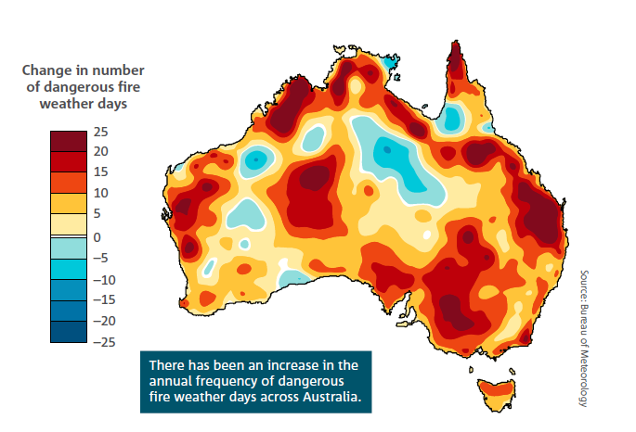
Increase in extreme fire weather
Increased frequency in extreme fire weather days (see map).
These increases are particularly evident during spring and summer and are associated with an earlier start to the southern fire weather season across much of Australia since the 1950s, especially in southern Australia.
Notes:
Source: State of the Climate 2020 https://www.csiro.au/en/Showcase/state-of-the-climate
Duration of extreme fire weather days is important for sector

Slide 10
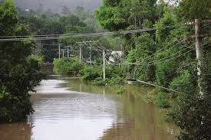
Heavy rainfall events are becoming more intense
Intensity of short-duration (hourly) extreme rainfall events has increased by around 10 per cent or more in some regions
As the climate warms, heavy rainfall events are expected to continue to become more intense
Notes:
Source: State of the Climate 2020 https://www.csiro.au/en/Showcase/state-of-the-climate
Image: to be replaced

Slide 11
Electricity sector vulnerabilities
Hazard | System exposure
Temperature | Reduces generator and network capacity, and increases failure rates while increasing cooling load demand. Increases electrical asset deterioration, increasing failure rates or maintenance/replacement costs.
Bushfire | Threat to all assets; smoke and heat represent high operational risk to transmission lines. Requires consideration in line route selection and design.
Wind | Affects wind generation output, plant profitability and design specifications. Implications for network capacity assessments, design specifications and failure rates.
Precipitation / Dam inflows | Reduces water for hydro generation and for cooling of thermal coal plants. Increases requirement for desalination loads.
Coastal inundation | Some low-lying generation, distribution and transmission assets may be affected. (Not considered by the ESCI project.)
Extreme and compound events | Widespread impacts on all assets. Vulnerability is time-dependent: during, aftermath, recovery.
Notes:
Temperature (increases in average, maximums & heatwaves)
Bushfire (increase in the frequency and magnitude of high fire danger weather)
Wind (possible reduction in average and likely increase in the frequency and magnitude of destructive gusts)
Precipitation / Dam inflows (likely reduction in average, likely increase in extreme precipitation events and flooding)
Coastal Inundation (increase in sea level)

Slide 12
Electricity sector vulnerabilities: Temperature (1)
Low temperatures drive increases in heating loads, and high temperatures drive increases in cooling loads
Network assets are rated for operating temperatures; increasing temperatures decrease available network capacity
Overhead transmission lines sag in heat
Some assets (thermal generation, station equipment, and cables) have capacity reductions at high temperature
Many network components have greater failure rates at high temperature
Notes:
Ref: AEMO Appendix 8

Slide 13
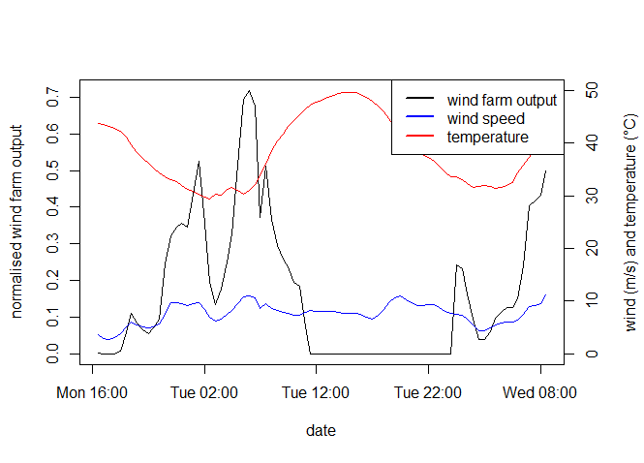
Electricity sector vulnerabilities: Temperature (2)
Temperatures during peak demand periods likely to increase in future
During peak demand periods:
Wind farm output likely to decline
Solar farm output likely to decrease slightly

Slide 14
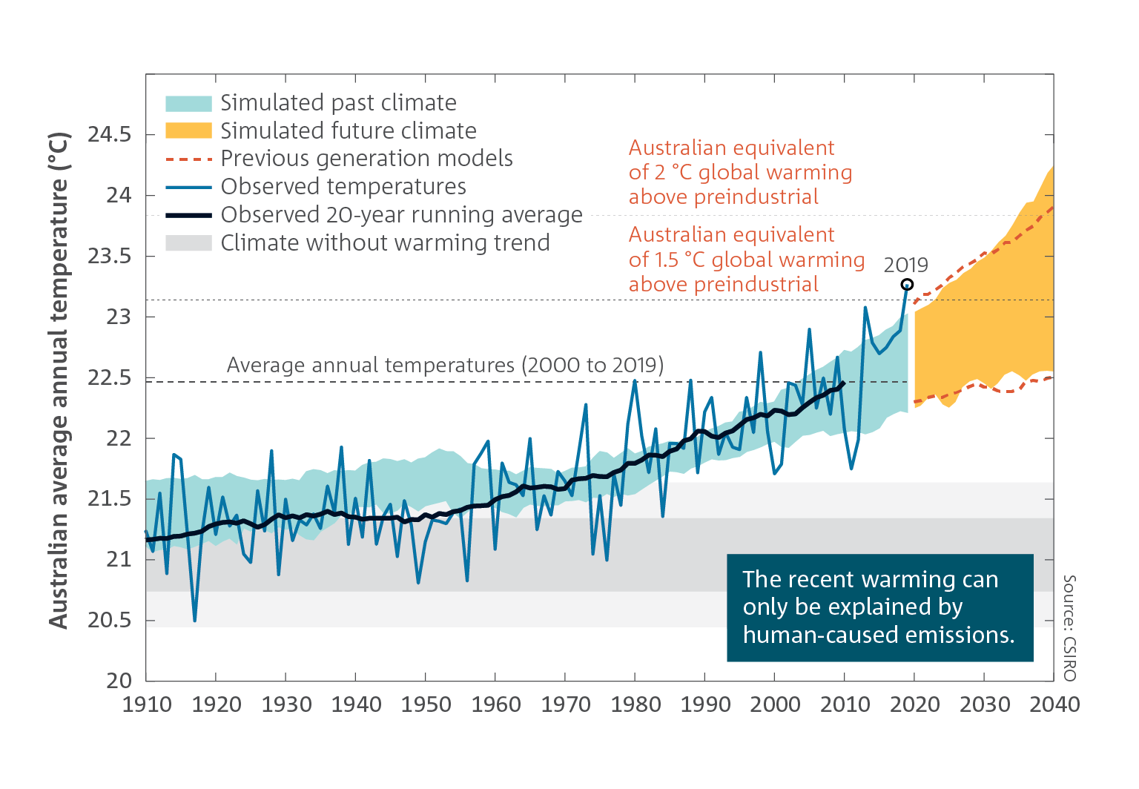
Electricity sector vulnerabilities: Temperature (3)
Temperatures past and projected
Notes:
State of the Climate 2020
Australian average annual temperature observed and simulated from global climate models. Past and future bands show the range of 20-year running average of new generation climate model results, dashed lines show the equivalent from the previous generation of global climate models. Climate without warming trend shows both an inner and an outer band which are one and two standard deviations, respectively, from the 1850–1900 average, i.e. prior to the rapid growth in greenhouse gas emissions from human activities. The black dashed lines show the Australian equivalent of the global warming thresholds 1.5 °C and 2 °C above the pre-industrial baseline period 1850–1900, equating to warming levels of around +2.1 °C and +2.8 °C respectively, based on the observed ratio of Australian to global temperature of around 1.4.

Slide 15
Electricity sector vulnerabilities: Bushfire (1)
Bushfires can cause widespread interruptions to electricity supply that can last for several weeks
Bushfires can burn wooden poles
Smoke and ash can disrupt insulation
Overhead electricity networks can cause bushfires

Slide 16
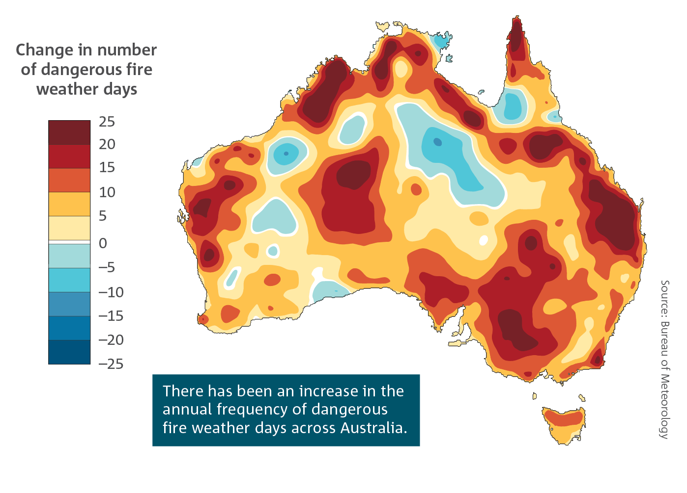
Electricity sector vulnerabilities: Bushfire (2)
There has been an increase in the number of days with dangerous weather conditions for bushfires.
Notes:
State of the Climate 2020: https://www.csiro.au/en/Research/OandA/Areas/Assessing-our-climate/State-of-the-Climate-2020/Australias-changing-climate
There has been an increase in the number of days with dangerous weather conditions for bushfires. This is based on the change in the annual (July to June) number of days between the two periods: July 1950 – June 1985 and July 1985 – June 2020 that the Forest Fire Danger Index exceeds its 90th percentile, which is an indicator of dangerous fire weather conditions for a given location.

Slide 17
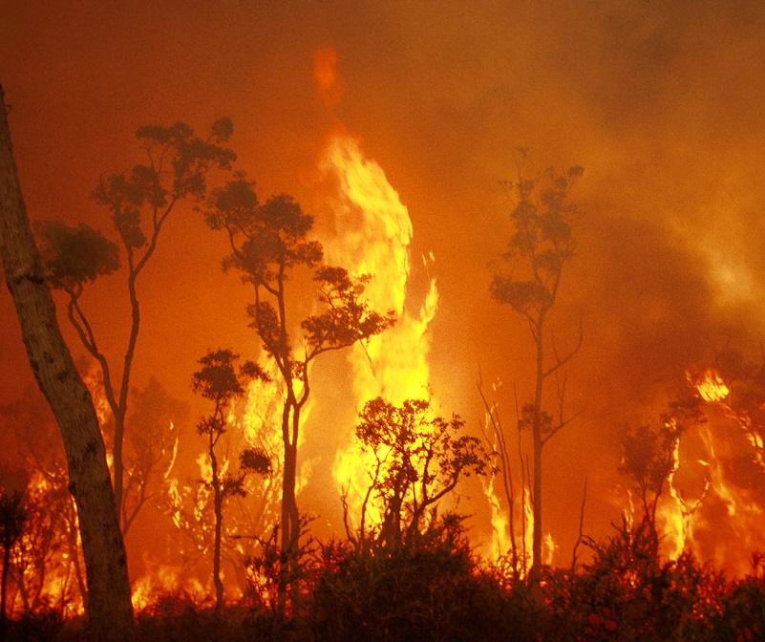
Electricity sector vulnerabilities: Bushfire (3)
Fire weather in December 2019 was the highest on record, with bushfires throughout New South Wales and Victoria. The NEM suffered numerous bushfire-related unplanned outages and lack of reserve events.
Smoke haze created additional challenges for demand and solar forecasting.
Notes:
Image: https://blog.csiro.au/bushfire-basics/

Slide 18
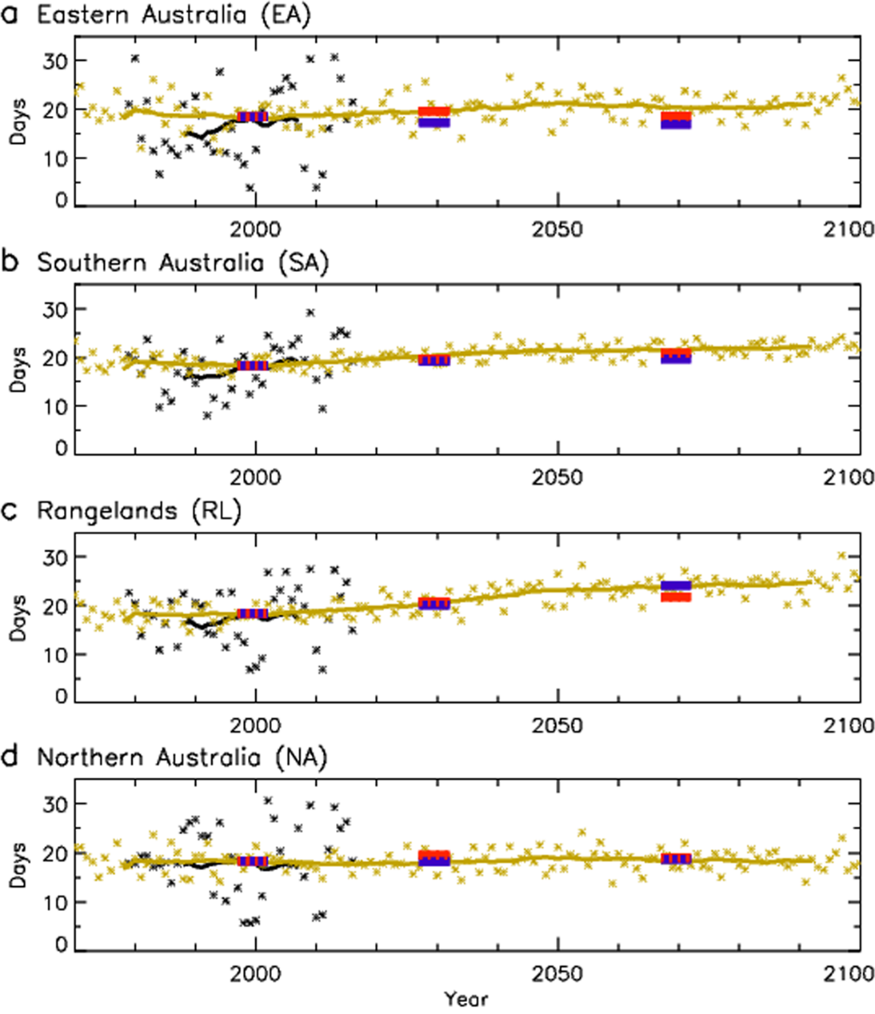
Electricity sector vulnerabilities: Bushfire (4)
More dangerous fire weather conditions are projected
Notes:
Dowdy, A, et. al. 2019, Future changes in extreme weather and pyroconvective risk factors for Australian wildfires, at https://www.nature.com/articles/s41598-019-46362-x.
Temporal changes in pyroconvection risk for four different climatic regions. Time series showing
regional trends from 1970–2100 in the average number of days with Continuous Haines index (CH) greater than its 95th percentile at a given
location. CH is used operationally by the Australian Bureau of Meteorology and fire agencies to provide guidance on
lower to mid-tropospheric conditions associated with dangerous pyroconvective processes
(Results are presented for four regions: (a) Eastern Australia; (b) Southern Australia; (c) Rangelands;
and (d) Northern Australia. (e) A map showing the four regions is provided, together with locations of capital
cities of Australia. Results based on reanalysis cover the period 1979–2016 (shown in black) and ensemble mean
values for GCMs cover the period 1970–2100 (shown in yellow), with ensemble mean values for CCAM (blue)
and WRF (red) covering the periods 1990–2009, 2030–2049 and 2060–2079. A 20-year running mean (i.e., boxcar
average) is applied to highlight the climatological signal, with results for individual years also shown for the
reanalysis and GCMs.

Slide 19
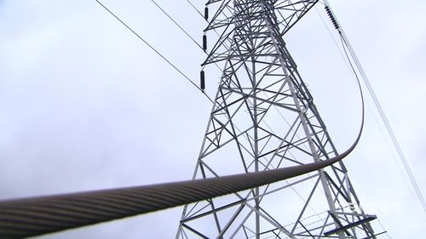
Electricity sector vulnerabilities: Wind (1)
Extreme wind can damage overhead assets directly, and by airborne debris.
Changes to average wind speeds will affect wind generation. Some wind generators shut down during high wind events.
Image: 9NEWS]
Notes:
Image: https://www.9news.com.au/national/nsw-news-fallen-powerlines-sydney-plumpton-fire-homes/c8079363-1a3e-48e9-8e3b-305c962e2293 [Permission not requested]

Slide 20
Electricity sector vulnerabilities: Precipitation (1)
Drought can reduce heat diffusion from underground cables. This can result in the maximum current rating of cables being reduced and cable faults.
Flooding can damage infrastructure, especially substations
Overhead power poles erected in cracking clay soils may experience accelerated leaning

Slide 21
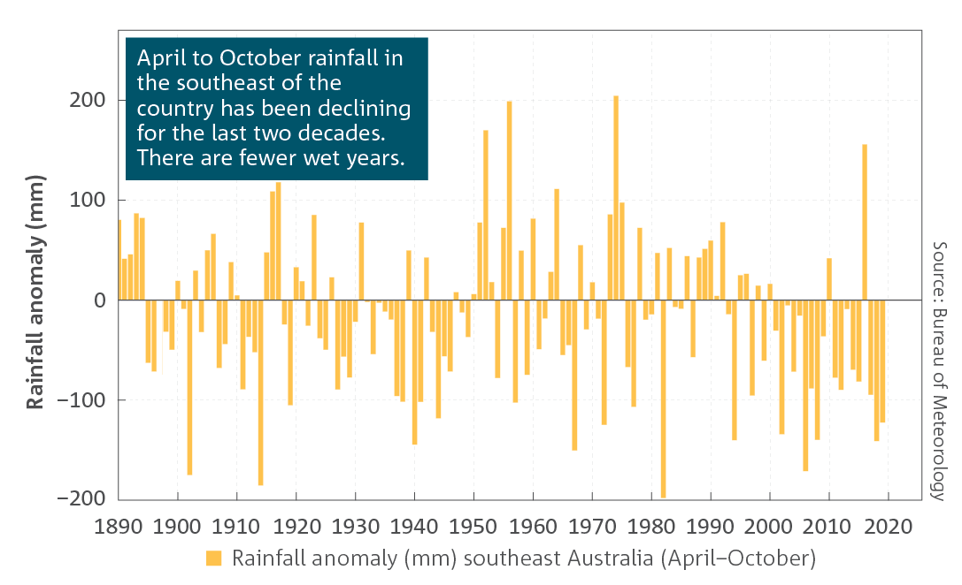
Electricity sector vulnerabilities: Precipitation (2)
Three quarters of hydrologic reference stations around Australia record a declining trend in streamflow.
Notes:
State of the Climate 2020
Anomalies of April to October rainfall for southwestern (southwest of the line joining the points 30° S, 115° E and 35° S, 120° E) and southeastern (south of 33° S, east of 135° E inclusive) Australia, with respect to 1961 to 1990 averages.
Three quarters of Australia’s hydrologic reference stations show a declining trend in streamflow, with a quarter of these showing a statistically significant declining trend. Hydrologic reference stations are an indicator of long‑term impacts from climate change on streamflow, as they are gauges in catchments with little disturbance from human activities and with at least a 30‑year record.

Slide 22
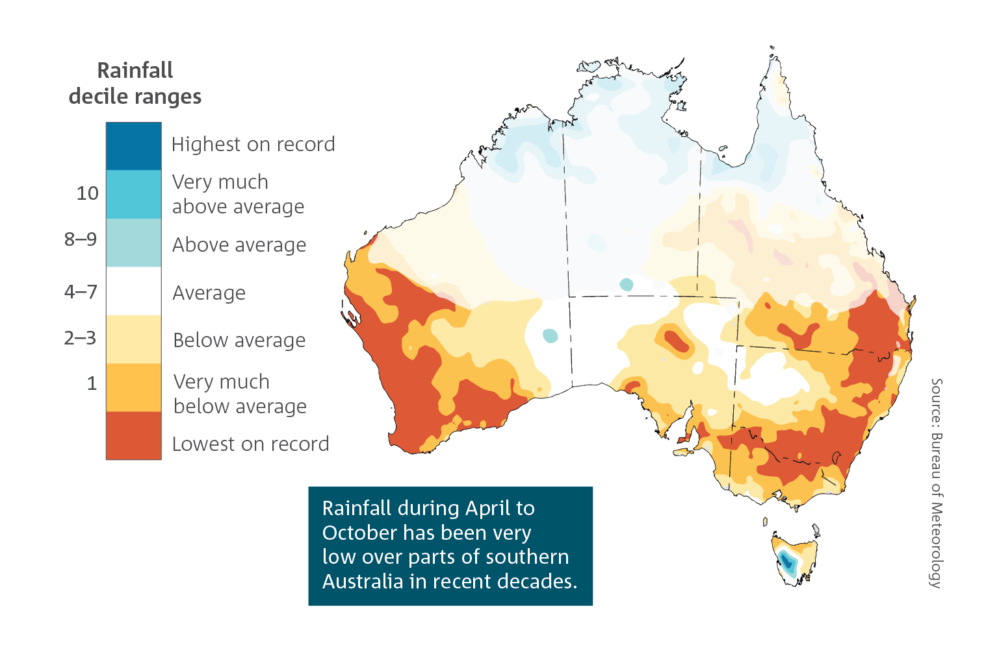
Electricity sector vulnerabilities: Precipitation (3)
Cool season rainfall 2000–19
Notes:
Key message:
Cool season rainfall over southern Australia has been very low in recent decades.
Notes on slide content:
The scale on the map ranges from lowest on record through to highest on record.
Source:
The 2018 State of the Climate is available at https://www.csiro.au/en/Showcase/state-of-the-climate

Slide 23
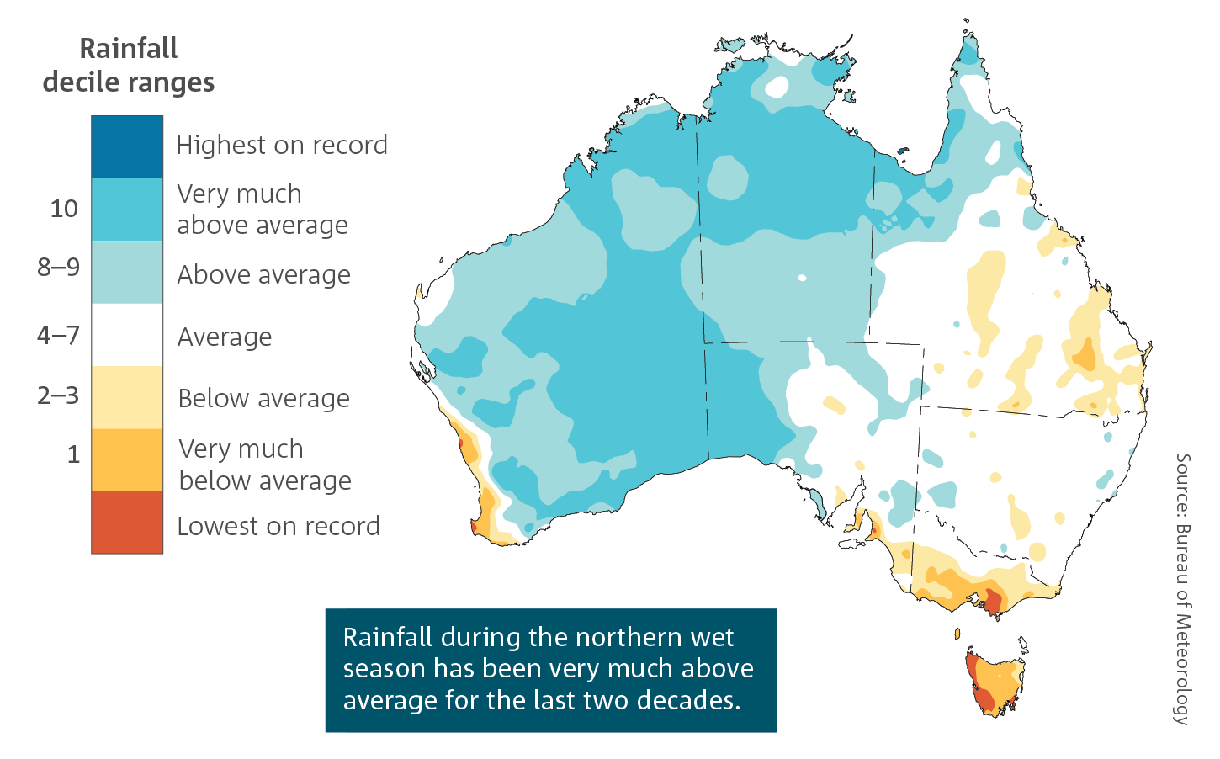
Electricity sector vulnerabilities: Precipitation (4)
Warm season rainfall 2000–20
Notes:
Key message:
Rainfall in the northern wet season has been above average over the last 20 years.
Notes on slide content:
The scale on the map ranges from lowest on record through to highest on record.
Source:
The 2018 State of the Climate is available at https://www.csiro.au/en/Showcase/state-of-the-climate

Slide 24
Electricity sector vulnerabilities: Precipitation (5)
Projected decrease in cool season rainfall across many regions of the south and east
Continued warming, with more extremely hot days and fewer extremely cool days

Slide 25
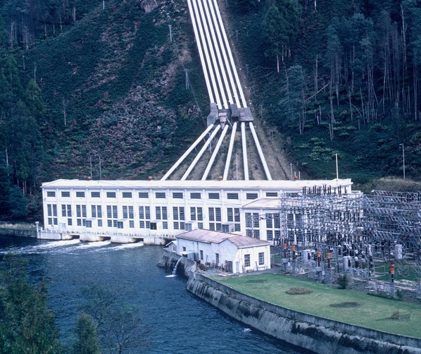
Electricity sector vulnerabilities: Precipitation (6)
Climate change is likely to lead to:
Reduced water for hydro generation and for cooling of thermal coal plants
Increased requirement for desalination loads
Notes:
Image: https://www.scienceimage.csiro.au/tag/-energy/i/2956/tarraleah-hydroelectric-power-station/

Slide 26
Electricity sector vulnerabilities: Coastal inundation (1)
Increased rate of inundation in exposed areas and increased areas exposed to inundation
Potential to increase outages due to tracking of insulators caused by salt deposits
Potential to increase higher levels of corrosion of steel structures fittings conductors and earth wires
Small increases in the sea level may cause large increases in extent of storm surges

Slide 27
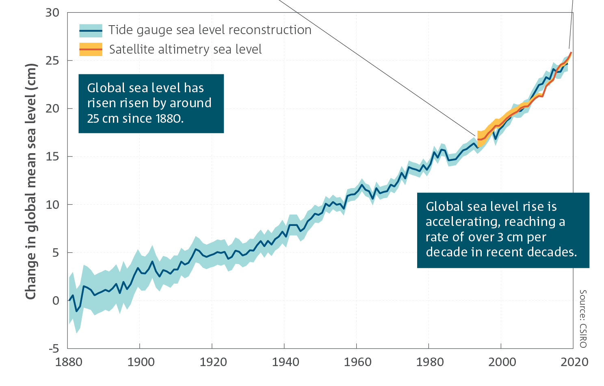
Electricity sector vulnerabilities: Coastal inundation (2)
Global mean sea level has risen by around 25 cm since 1880; half of this rise has occurred since 1970.
Notes:
State of the Climate 2020
Annual global sea level change from 1880 in tide gauge data (1880–2019, blue line, shading indicates confidence range), and annual sea level change in satellite altimetry (1993–2019, orange line).

Slide 28
Electricity sector vulnerabilities: Coastal inundation (3)
Recent research suggests the upper end of projected global mean sea level rise could be higher than previously assessed: as high as 0.61 to 1.10 m global average by the end of the century for a high emissions pathway (although changes vary by location).
More frequent extreme sea levels. For most of the Australian coast, extreme sea levels that had a probability of occurring once in a hundred years are projected to become an annual event by the end of this century with lower emissions, and by mid-century for higher emissions.
Notes:
State of the Climate 2020
https://www.ipcc.ch/srocc/

Slide 29
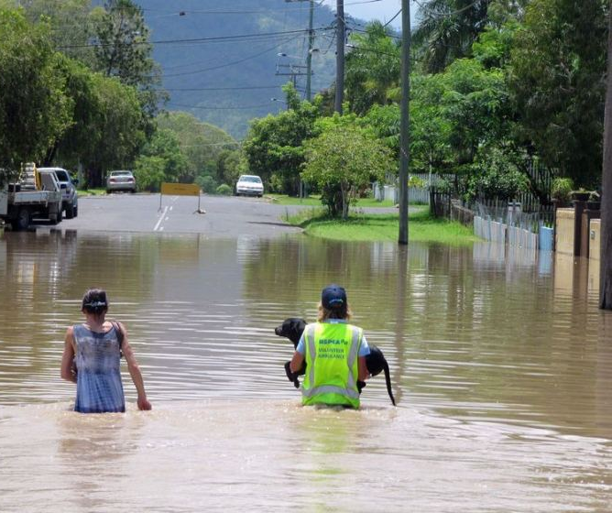
Electricity sector vulnerabilities: Extreme and compound events (1)
These events can have widespread upstream and downstream impacts on all assets
Impacts on other sectors can affect the energy network, and vice versa
Notes:
Image: https://ecos.csiro.au/city-planning-for-heavy-rain/

Slide 30
Electricity sector vulnerabilities: Extreme and compound events (2)
Events that are most impactful and hazardous tend to be the result of the combined influence of extremes in multiple variables occurring simultaneously
Climate change can have a significant influence on the frequency, magnitude and impact of some types of compound events
The warming trend, primarily caused by climate change, increases the likelihood of extreme events that are beyond historical experience
A continuing trend of more frequent compound extreme events is likely, although projection of such events is a significant scientific challenge
Notes:
AEMO Appendix 8
In climate science, compound events can be:
• Two or more extreme events occurring simultaneously or successively,
• Combinations of extreme events with underlying conditions that amplify the impact of the events, or
• Combinations of events that are not themselves extremes but lead to an extreme event or impact when combined30

Slide 31
ESCI’s approach

Slide 32
Tailored climate information to support industry decision-making
Hazards
Temperature
Wind
Bushfire
Precipitation
1. Trends in climate variables affecting supply and demand
Time series with high temporal and spatial resolution
2. High-impact weather simulations
Synthetic compound or coincident extreme synoptic weather events
3. Regional thresholds for key climate variables
Probability of exceedance for temperature, wind gusts, fire danger
Long-term risk (2030-2060+)
Investment risk
Reliability risk
Operational/ Resilience risk
Standardised approach to developing climate scenarios including understanding of uncertainty and confidence
Notes:
Part of the project involves consultation with industry, which we have had to largely limit to AEMO, the TNSPs and some types of generation given the available budget.
They have told us what is important for decision-making around climate and extreme weather for
Reliability
Resilience
Operating risk.

Slide 33
ESCI Climate Risk Assessment Framework Based on ISO 14090 – adapting to climate change
ESCI focus
Visions goals and objectives
Decisions which are susceptible to climate change risk
Relevant stakeholders
Stakeholder
responsibility
1. Understand context
Risk assessment
Identify relationship between asset/decision and weather
Analyse impact of future climate
Evaluate risk
6. Monitor, evaluate, adapt
2. Assess impact
Repeat for planning cycles or in response to events
5. Implement
3. Test adaptation options
Risk treatment:
Identify adaptation options
Test options using climate risk assessment
ESCI contributes
4. Make decisions

Slide 34
What we have heard from stakeholders
The sector is concerned with climate change as a threat to assets and operations, but:
Sector users are unsure where to get credible data or which data to use
A climate risk assessment is not currently required by investors, insurers or system managers
Perception that climate projections are not accepted by regulators to justify investment
Moving from decisions based on history to decision making for a very different future is profoundly challenging.
The impact of including climate change data in National Electricity Market planning will be incremental but important
Testing the climate data and the risk framework generally results in people being more comfortable that the long-term impact of climate change can be accommodated
In planning timeframes, multiple incremental changes, guided by future climate information, will add up to a more reliable and resilient network.
All operators remain concerned about the increasing frequency and severity of extreme and compound weather events.
The project has been welcomed by the sector stakeholders who have been actively and increasingly engaged.

Slide 35
Use of climate information (preliminary)
Hazard | Data use in operations and planning
Temperature time series & thresholds | VRE investment cases and design specifications Market modelling and management on high demand days Specifications for transmission and distribution lines
Bushfire thresholds | Considered in line route selection and design Support fuel management and operational decisions Portfolio assessment by finance and insurance
Wind thresholds | VRE investment cases and design specifications. Specifications for transmission and distribution lines Useful for network capacity assessments, design specifications and failure rates
Precipitation / Dam inflows | Hydro generation availability Thermal buffering of underground distribution lines Grounding of transmission and distribution towers
Extreme event case studies | Stress testing operational procedures Assessing consequence of possible compound events Investing for increased resilience

Slide 36
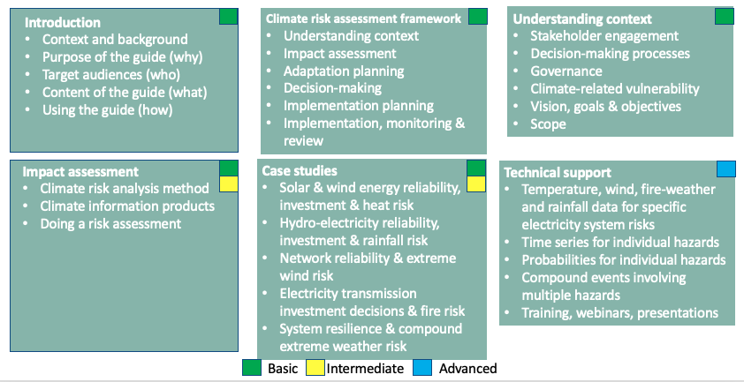
Climate risk assessment guidance for the electricity sector

Slide 37
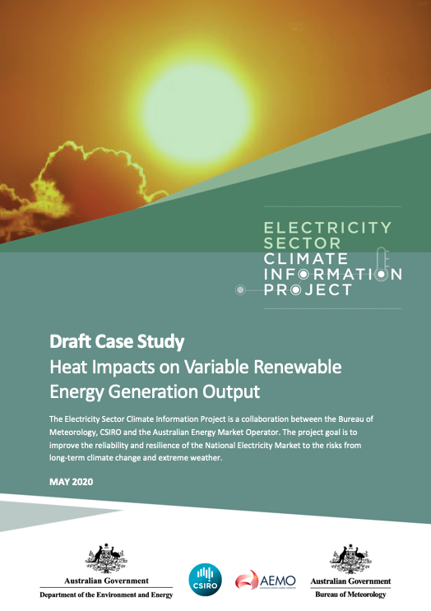
Case studies: How to use ESCI products
Heat: analyses risks to renewable energy investment and system reliability associated with increasing extreme temperatures
Bushfire: how frequency and magnitude of bushfires near major transmission lines are likely to change, and effects on investment decisions
Wind: impacts of changes in average wind speed and intensity and frequency of destructive wind gusts
Extreme events: system risk from compound heat wave/high wind event
Hydrology: risks to hydro-power of reduced rainfall and increasing rainfall variability

Slide 38
ESCI products: information
Exceedance maps for key climate variables
Seasonal data and information on trends such as heatwaves
Time series for multiple variables at key locations such as renewable energy zones or along interconnectors
POE probability of exceedance

Slide 39
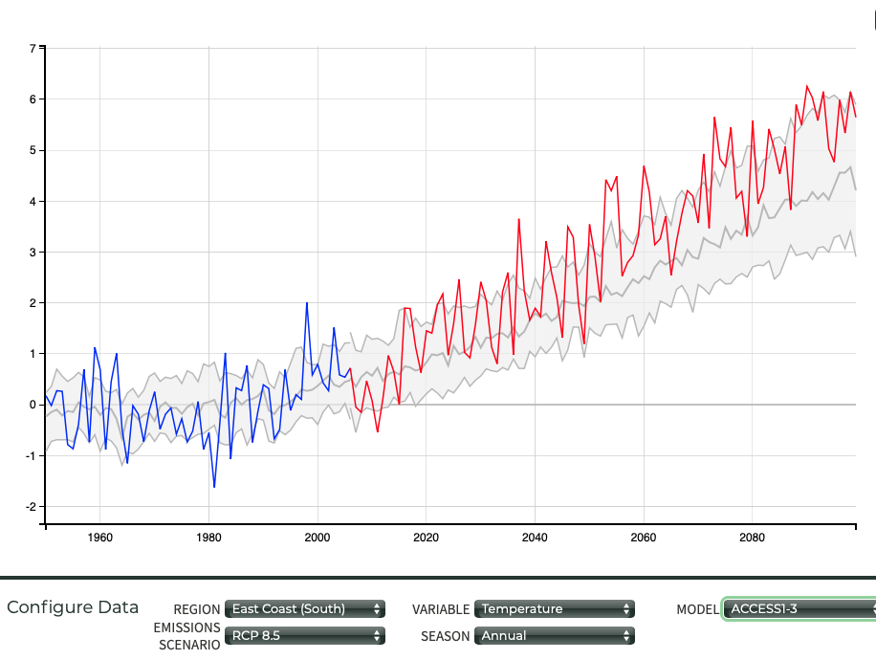
ESCI products: Data
Time series of past climate data (back to 1980 and earlier) and projections (to 2060) for variables of use to the electricity sector, including temperature, wind and fire weather
Based on selected climate models that represent range of change for Australia.
Where necessary, higher resolution achieved via ‘downscaling’
2 future greenhouse emission pathways (RCPs 4.5 (low emissions), and 8.5 (high))
Notes:
The plot displays three types of data. Grey band (or plume): the range of model results is summarised using the median (central grey line) and 10th to 90th percentile range of the projected change in all available CMIP5 simulations.
Blue line: the historic simulation from the one selected model (note that it is possible to select the historic AWAP data to display).
Red line: the future simulation from the one selected model.

Slide 40
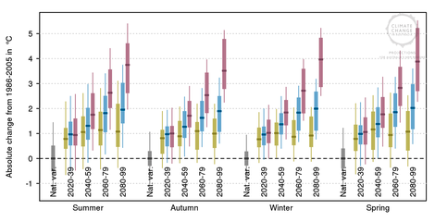
Projections available for selected climate variables
Temperature
Wind (average and gust) (TBC); 10 m, 150 m and 250 m wind speed and direction
Bushfire weather (forest fire danger index)
Maps of temperature exceedance probabilities
2 m air temperature (dry bulb), dew point temperature, relative humidity
Precipitation
Surface pressure
Global horizontal irradiance (GHI)
Direct normal irradiance (DNI)
Notes:
Image: CCIA

Slide 41
ESCI deliverables
Guidance materials, training, user-testing and engagement with industry to tailor and communicate climate information
Contribute to understanding long-term climate risk, including to network vulnerabilities
Tailored climate data and information, including high-resolution projections of selected climate variables
Joint project of the Department of Industry, Science, Energy and Resources, CSIRO, the Bureau of Meteorology and AEMO
www.climatechangeinaustralia.gov.au/en/climate-projections/future-climate/esci/

